Slide 1
Connection design by Component Based Finite Element Method
Lecture 4
Column base

Slide 2
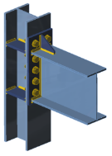
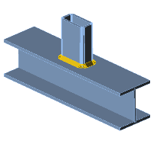
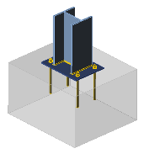
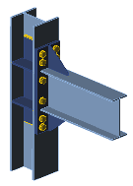
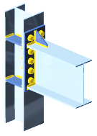
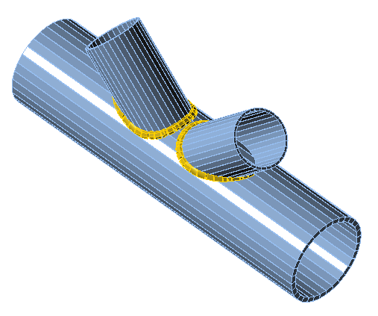
List of lectures
Beam to column moment connection
Hollow section joints
Joint of hollow to open section
Column base
Seismically qualified joints
Joints at elevated temperature

Slide 3
Aims and objectives
Provide information on the behavior of the column base
Introduce the principles of the Component Method (CM) for column base design
Introduce the principles of Component Based Finite Element Method (CBFEM) for the column base
Provide an online training to students and engineers
Illustrate the differences between numerical simulation and numerical calculation, e.g., between research-oriented
and design-oriented FEM.
Show the process of Validation & Verification
Offer a list of references relevant to the topic

Slide 4
Lecture 4
Column base
František Wald, Marta Kuříková, Abhishek Ghimire,
Martin Vild, Lubomír Šabatka, Jaromír Kabeláč, Drahoš Kojala

Slide 5

Tutorial
This lecture describes the principles of Finite Element Method of column base by applying Component Based FEM (CBFEM).
The behavior of the base plate subjected to compression and bending is shown on the analytical design by the component method.
Validation, verification and benchmark cases using Component Based Finite Element Method are presented.
Material was prepared under the R&D project MERLION II supported by Technology Agency of the Czech Republic, project No TH02020301.

Slide 6
Outline of the lecture
Introduction
  Anchor bolts
  Classification
  Assessment I
Component method
  Component in compression
  Component in tension
  Assembly of components
  Assessment II
Component Based Finite Eelement Method
  Validation
  Verification
  Sensitivity study
  Benchmark case
  Assessment III
Summary

Slide 7
Introduction
Lecture 4
Column base

Slide 8
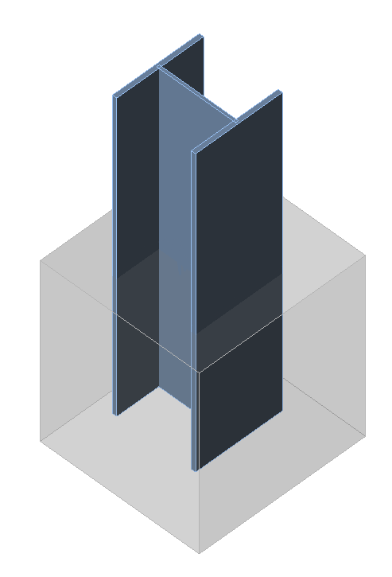
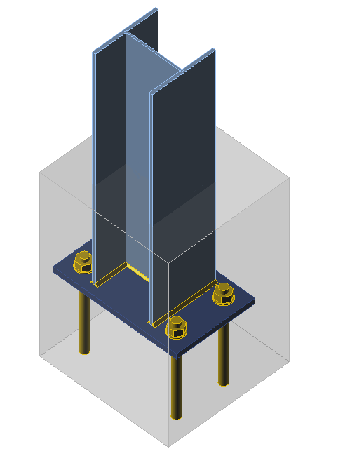
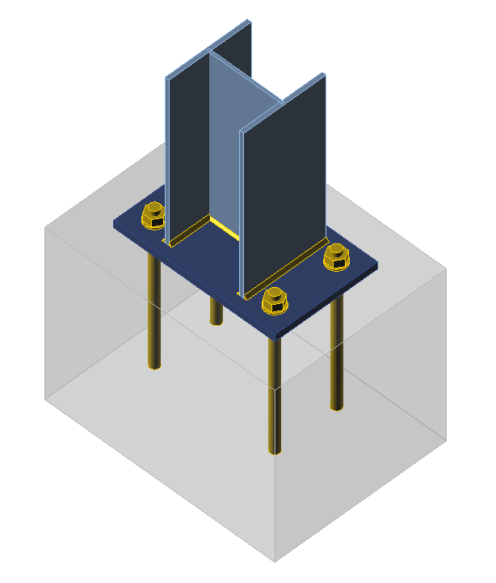
Introduction
Steel structures are fixing to concrete foundation/structure by base plate/end plates, embedding and its combination.
The aim of this lecture are joints with base plate fixed to concrete structure by anchor bolts.

Slide 9
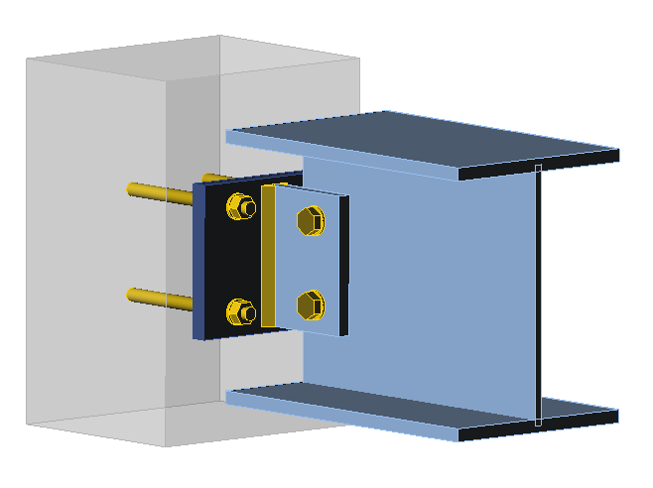
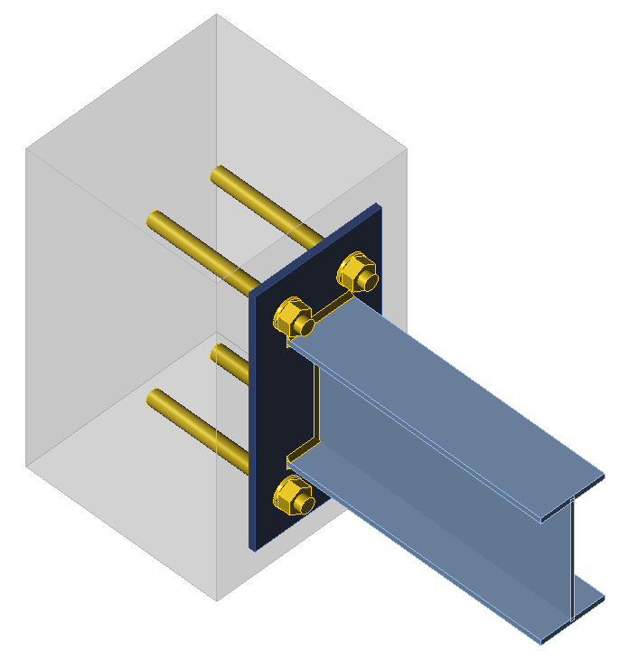
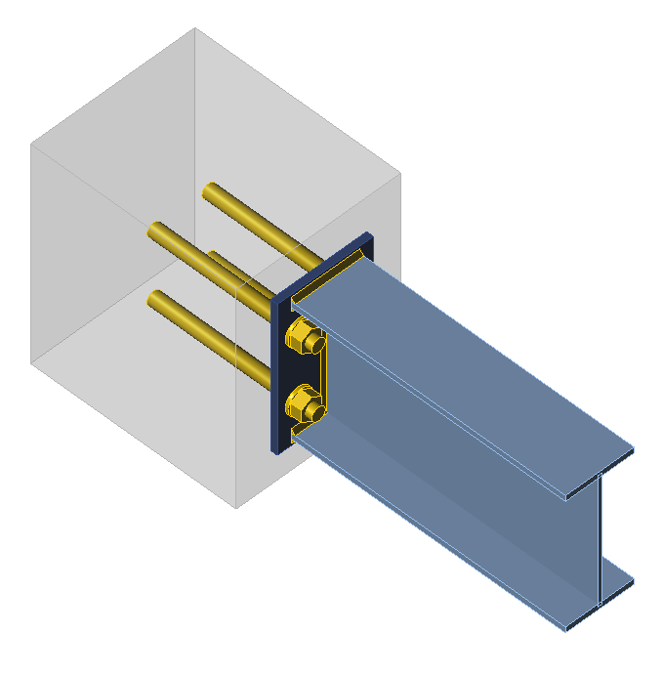
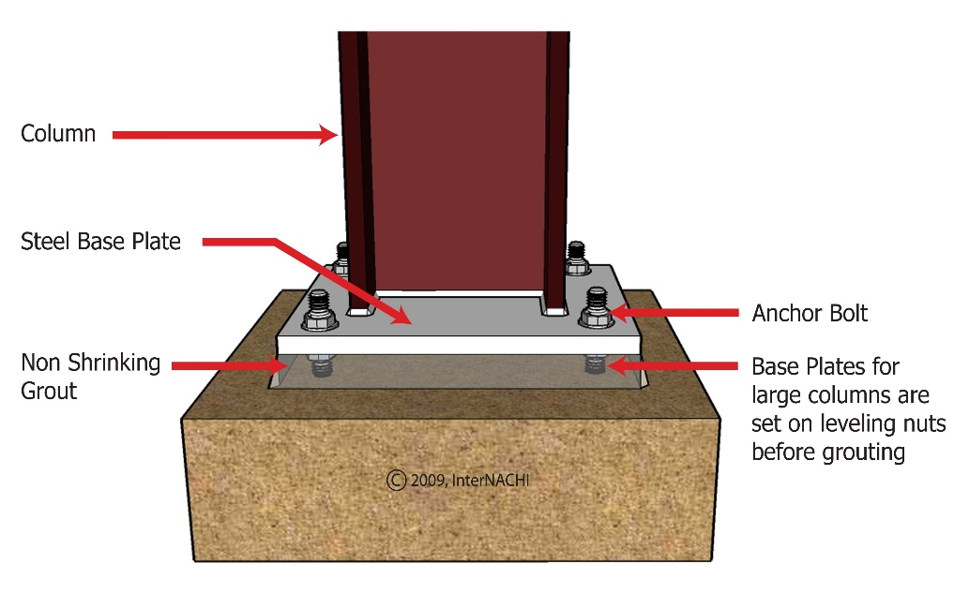
Introduction
The same principles are used for end plate fixed to concrete structure by anchor bolts.
The base plate is usually positioned on the concrete block by pickings or levelling nuts and fixed by grout. The erection has no substantial influence to design resistance.
If the anchor bolts
are designed not embedded
(during erection or use)
it takes into account in design.

Slide 10
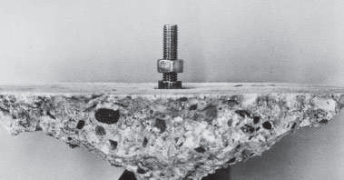
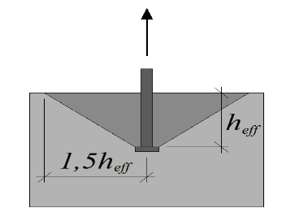
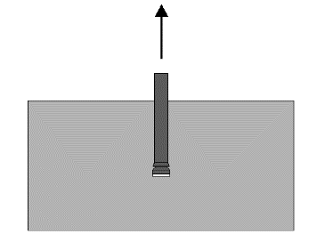
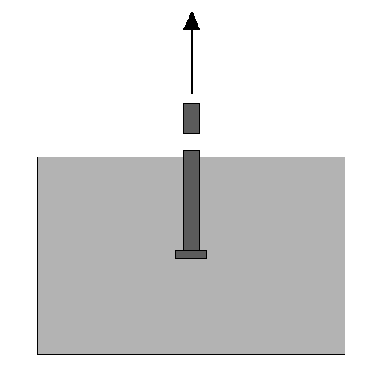
Design resistance of anchor bolt in tension
  Anchor bolts are designed for its resistance in tension according to EN1992-4:2018 for all possible failure modes.
  Basic failure modes in tension are:
    Steel failure of fastener
    Concrete cone failure
    Pull-out failure of fastener
    Note: In structural steel column bases is asked the ductile steel fastener´s failure mode, if structurally possible, compared to anchoring of secondary structures.

Slide 11
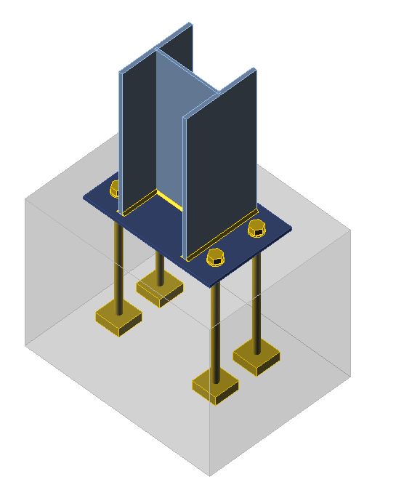
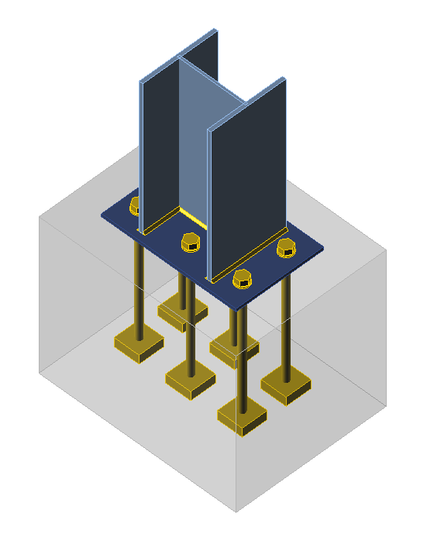
Distribution of forces between anchor bolts in tension
  EN1992-4:2018 expects, that forces between anchor bolts are distributed elastically. It meets the column base with one anchor bolt row.
  Plastic analyses according to CEN/TR 17081:2018 is used for distribution of bolt forces for more anchor bolt rows in tension. In this case is asked to be the govern failure ductile, e.g. the steel failure of fastener. The developed prying forces are taken into account .

Slide 12
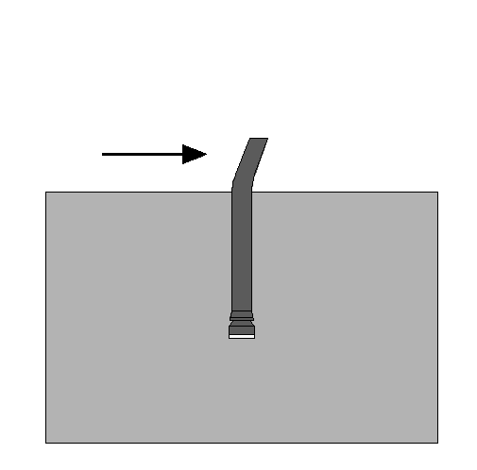
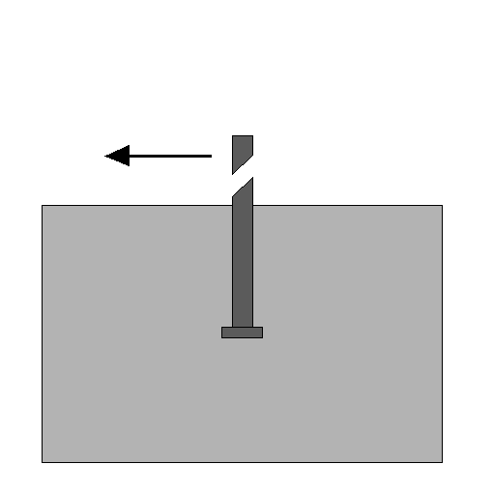
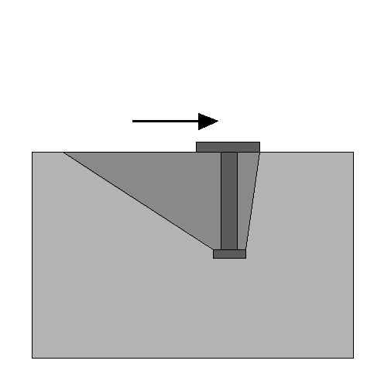
Design resistance of anchor bolt in shear
Anchor bolts for resistance in shear are designed according to EN1992-4:2018 for all possible failure modes.
Basic failure modes in shear are:
    Steel failure of fastener
    Concrete edge failure/Pry-out failure
    Pull-out failure of fastener

Slide 13
Column base classification
  To simplify global analyses are classified joints in Ch. 5
  of EN1993-1-8:2006 based on
  Best engineering practice
  Actual influence of particular joint to current frame design, which implicates recalculation.
  Simplified assumption of frame behaviour
According to initial joint bending stiffness are column bases classified
  Similar to beam-to-column joints
  Related to the column bending stiffness

Slide 14
Column base classification by bending stiffness
Limit between rigid and semi-rigid column bases based on simplified assumption of frame behaviour.
For non-sway frames is derived from column resistance
for ≤ 0,5 S_{j,ini} ≥ 0
for 0,5 < < 3,93 S_{j,ini} ≥ 7 (2 - 1) E I_{c} / L_{c}
and for ≥ 3,93 S_{j,ini} ≥ 48 E I_{c} / L_{c}
where is relative slenderness for simple supported column at both ends.
Is valid for limited stiffness 12 E I_{c} / L_{c}
For sway frames is derived from limiting sway
The limit between pinned and semi-rigid is expected 0,5.

Slide 15
Column base classification by bending stiffness
Below are shown the limits between rigid, semi-rigid column and pinned column bases based on simplified assumption of frame behaviour.
The limits assure accuracy in design of frame 5% for resistance and 20% for serviceability.

Slide 16
Classification of column base in non-sway frame
Below is shown the influence of bending stiffness of two column bases to the column buckling length on example of column HEB200.
On the vertical axes is parameter of buckling length β; β = 0,7 for rigid column base and β = 1,0 for pin one. On the horizontal axes is the relative slenderness of base plate to column in logarithmic scale. The points represent influence of the real column bases on buckling length.

Slide 17
Classification of column base in sway frame
Below is shown the influence of bending stiffness of column bases in sway portal frame.
On the vertical axes is parameter of sway y_{s}/y_{p}; y_{s}/y_{p} = 0,33 for rigid column base and y_{s}/y_{p} = 1,0 for pin one. On the horizontal axes is the relative slenderness of base plate to column in logarithmic scale. The points represent influence of the real column bases on buckling length of columns.

Slide 18
Assessment I
What are the basic failure modes of anchor bolts in tension?
What should be the failure mode of anchor bolt in case of plastic distribution of forces in column base with more bolt rows?
What are the basic failure modes of anchor bolts in shear?
What is the reason of classification of joints by bending stiffness?
What principles are used for classification of joints by bending stiffness?
For what accuracy was derived the limit between rigid and semi-rigid column bases for simplified assumption of frame behaviour?

Slide 19
Component method
Lecture 4
Column base

Slide 20
Component method for column bases
In the first step of component method is the joint divided into components.

Slide 21
Component base plate in bending and concrete block in compression
  Base plate is flexible under rigid flange/web plates and is taken into account in design by
  Effective rigid area under the flexible plate A_{eff}.
  Concrete block occurs in spatial stress and is taken into account in design by
  Concrete design strength in joint f_{jd}.

Slide 22
Concrete design strength in joint f_{jd}
  Concrete design strength in joint f_{jd} is derived from the concrete resistance to concentrated force F_{Rd,u}.
  where
  β_{j} is joint coefficient due to lower quality of grout
  compared to concrete and is taken 2/3
  f_{cd} is concrete compressive strength

Slide 23
Concrete resistance to concentrated force F_{Rd,u}
  Concrete resistance to concentrated force F_{Rd,u} is taken as homogenous force F_{Rd,u} on the loaded area A_{c0}. It is limited by geometry of concrete block.
  Note:
  In spatial stress is failure mode
  crushing of concrete under the base plate.

Slide 24
Concrete resistance to concentrated force F_{Rd,u}
  Concrete resistance to the concentrated force F_{Rd,u} is calculated from the geometry of the concrete block as
    A_{c0} = b₁ d₁
    A_{c1} = b₂ d₂
    h ≥ b₂ – b₁; h ≥ d₂ – d₁
    3 ⋅ b₁ ≥ b₂ and 3 ⋅ d₁ ≥ d₂
  where
  f_{cd} is concrete the compressive strength
  A_{c0} is the area of crushing of the concrete Cl. 6.7(2) in EN 1992-1-1

Slide 25
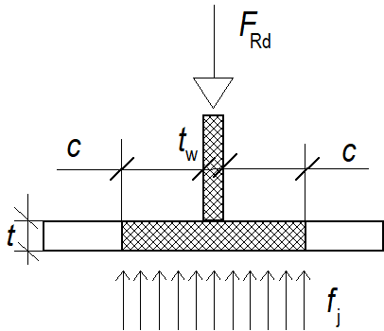
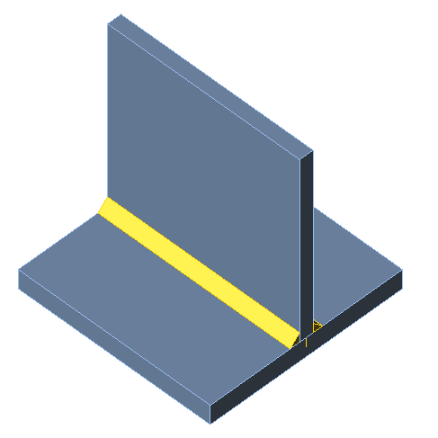
Effective flexible plate on the concrete block
Effective flexible plate on the concrete block, where is reached the concrete design strength in joint f_{jd}, is limited by elastic deformation of the base plate. From this assumption is calculated effective width c round the column´s flanges/webs as
where
t is the plate thickness
f_{y} is the base plate yield strength
f_{jd} is the design bearing strength of the joint
γ_{M0} is the partial safety factor for concrete

Slide 26
Effective area under the base plate
The effective area of design contact under the base plate is created around the column´s web and flanges by the T-stub effective width c
Into account is taken only real the projection of the physical length of the basic joint component represented by the T-stub.

Slide 27
Stiffness of component concrete in compression and base plate in bending
Stiffness coefficient of concrete in compression under base plate is taken as deformation of elastic hemisphere
where a_{eq,el} is effective width of T-stub
L is the flange/web length
Effective T-stub width a_{eq,el} in elastic stage may be assumed as

Slide 28
Comparison to experiments
On the graph is compared the prediction of stiffness of component concrete in compression and base plate in bending.
On the vertical axes is the applied force and on horizontal axes the deformation.

Slide 29
Influence of grout to column base resistance
Grout with higher strength than concrete block may be taken into account to improve resistance.
Grout with lower strength than concrete block behaves under base plate as liquid and is taken into account by joint reduction factor β_{j}.

Slide 30
Component anchor bolts in tension and base plate in bending
T-stub created by the base plate, column flange/web and anchor bolts behaves differently compared to the T-stub created by end plate, beam flange/web and bolts in the bolted end plate connection because
  Base plate is thicker
  Anchor bolt free length is longer

Slide 31

When the prying force may not develop?
The base plate contact to concrete block depends on ration between bolt tensile stiffness and base plate bending stiffness.
Prying forces may develop if
where
L_{b} is the anchor bolt elongation length, taken equal to the grip length (total thickness of material and washers), plus half the sum of the height of the anchor bolt head and the height of the nut, or the anchor bolt length, taken equal to the sum of 8 times the nominal anchor bolt diameter, the grout layer, the plate thickness, the washer and half the height of the nut,
A_{s} is the tensile stress area of the anchor bolt
t is the base palte thickness
L_{eff} is the T stub effective lenght
$$L_{b}≤\frac{8,82∙m^{3}∙A_{s}}{L_{eff}t^{3}}$$

Slide 32
Failure mode 1-2 without prying
The failure mode 1-2 is derived to avoid contact of the base plate to the concrete surface.
Design resistance for failure mode 1–2 is governed by plate failure
where m is the lever arm of the anchor bolt.
is the plastic moment resistance of the base plate with
ℓ_{eff} is the effective length of the T-stub and
t_{eff} is the base plate thickness.

Slide 33
Graphical representation of the failure mode 1-2 of the T-stub of anchor bolts in tension and base plate in bending
The difference between failure mode 1 and 2 and failure mode 1-2 is shown on the diagram below, where on vertical axes is acting force F divided by the anchor bolts resistance and on horizontal axes is T-stub bending resistance of base plate divided by the anchor bolts resistance.
B_{t.Rd} is anchor bolt tensile resistance
m_{pl,Rd} is base plate bending resistance of unique length
Failure
mode 1

Slide 34
Anchor bolt effective length L_{eff}
Anchor bolt effective length L_{eff} consists of bolt free length L_{bf} and free embedded length L_{be} .
L_{eff} = L_{bf} + L_{be}
L_{eff} ≈ 8 d
where d is anchor bolt diameter.

Slide 35
Effective length of T-stub is different in case of prying/no prying
E.g. for base plate with bolts inside the flanges is the effective length
  in prying case
  in no prying case

Slide 36
Stiffness is different in case of no prying
The stiffness coefficient for plate without prying is derived the stiffness coefficient
for plate as
and for anchor bolt as
where t is the base plate thickness

Slide 37
Comparison to experiments
The model of anchor bolt in tension is validated against the experiment in Figure below and the good prediction of the resistance and stiffness of the current models is shown.

Slide 38
Comparison to experiments
The model of the T-stub of component anchor bolt in tension and base plate in bending is validated against the experiment in Figures below and the good prediction of the resistance and stiffness of the current component model is shown.

Slide 39
Bending resistance
The calculation of the column base resistance is based on the plastic equilibrium of forces on the cross section created by anchor bolts in tension and part of the concrete under base plate in compression.
Then, the column base
moment resistance M_{Rd}
is

Slide 40
Interaction diagram
Moment – normal force interaction diagram describes the design resistance of base plate by changing the eccentricity of loading with significant point at changes of effective area.

Slide 41
Bending stiffness
The column base bending stiffness is derived on simplified model with acting compression force under column flange and tension force in centre of bolt row from the component deformation for two cases
Bolts are activated Bolts are not activated

Slide 42
History of loading
The column base bending stiffness depends on history of loading. It is higher, if the column base is first loaded by compression and then by bending compared to, if it is loaded by reverse.

Slide 43
Comparison to experiment
On Figures below is validated the model of the column base against the experiment to show the good prediction of the resistance and stiffness of the current component model.

Slide 44
Comparison to experiment
On Figure below is validated the model of the column base proportionally loaded by moment and normal force with the bolt steel failure mode against the experiment to show the good prediction of the resistance and stiffness of the current component model.

Slide 45
Comparison to experiment
On Figure below is validated the model of the column base non-proportionally loaded by moment and normal force with the concrete cone failure mode against the experiment to show the good prediction of the resistance and stiffness of the current component model.

Slide 46
Sensitivity study
Figure below shows the sensitivity of the bending moment resistance and the bending stiffness of the column base proportionally loaded by normal force with eccentricity.
From base plate thickness are governing anchor bolts.

Slide 47
Assessment II
What are the basic components on base plate?
What are the major question in design of component in compression?
What is the reason for introducing the joint coefficient?
What is the reason of limiting the effective width of the base plate?
What is the reason, that prying may in case of Failure mode 1-2 not develop?
How is simplified the model of acting compression force for prediction of the column base stiffness?

Slide 48
Component Based FEM
Lecture 4
Column base

Slide 49
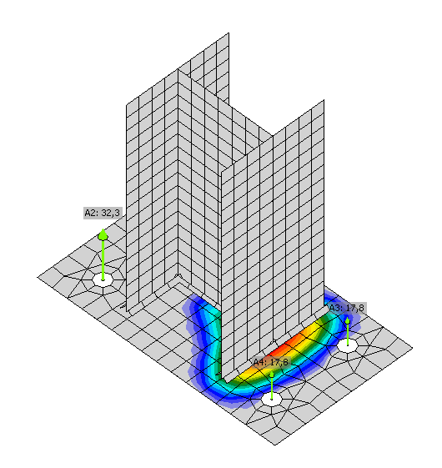
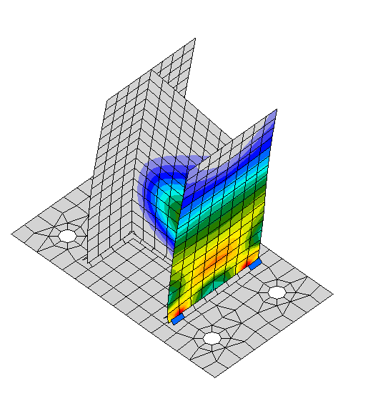
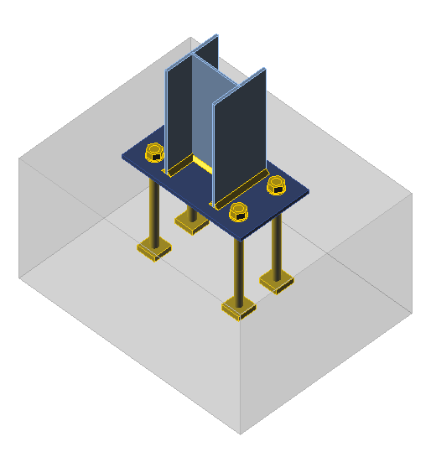
Concept of Component Based Finite Element Method for column bases
Steel part of column base, column base, column, base plate and stiffeners are simulated by shell models.
Resistance is limited by 5% of plastic strain.
Concrete block is taken as component with elastic-plastic surface.
Anchor bolts/welds are modelled as components.
Stress in concrete
Plastic strain in column

Slide 50
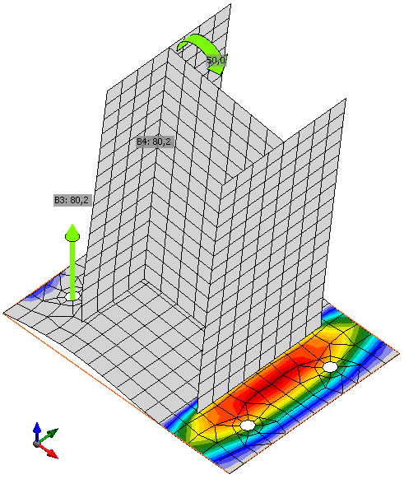
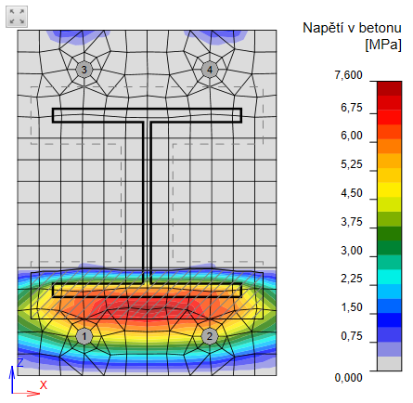
Component concrete in compression
For resistance is considered the part of the concrete block under effective area A_{eff} only using overlap c,
where the base plate deforms in its elastic stage, following the engineering assumption formulated in EN1993-1-8:2006.

Slide 51
Component anchor bolt in tension
The resistance of the anchor bolt in tension is taken from concrete components resistance and from the steel one.
Maximum allowed plastic strain for anchor bolts ε_{mpb} is taken as 25 % of elongation till fracture.
The stiffness in tension is calculated as
k = E A_{s}/L_{b},
where
A_{s} is tensile area of anchor bolt and
L_{b} is the distance between the centers of the head and the bolt nut.
Vertical force in anchor bolt, kN
F_{t,Rd}
F_{t,el}
k_{t}
F_{c,Ed}
k
u_{el}
u_{t,Rd}
Vertical deformation, mm

Slide 52
Component anchor bolt in shear
The resistance of anchor bolt in shear is calculated according to EN1992-4:2018 and EN1993-1-8:2006.
Stiffness of anchor bolt in shear includes bearing of concrete and
bending of bolt.
Shear force in anchor bolt, kN
F_{t,Rd}
F_{t,el}
k_{t}
F_{c,Ed}
k
u_{el}
u_{t,Rd}
Horizontal deformation, mm

Slide 53
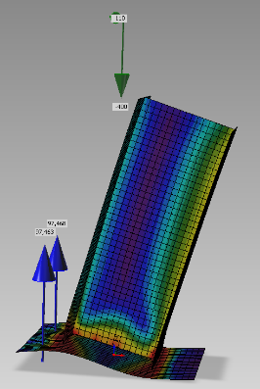
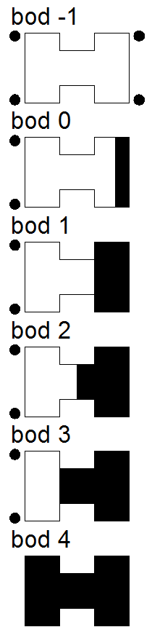
Normal force and bending moment interaction diagram
The cross section under base plate consists of anchor bolts and contact to concrete.
The significant points on interaction diagram reflects changes of geometry of compressed part.
The cross section exposed to normal force and bending behaves like concrete column cross section of effective contact area.
Point -1
Point 0
Point 1
Point 2
Point 3
Point 4

Slide 54
Experiments for validation
For validation were prepared two experiments in uniaxial and two in biaxial bending at TU Brno.
The experimental set ups is presented below.
Uniaxial bending
Biaxial bending

Slide 55
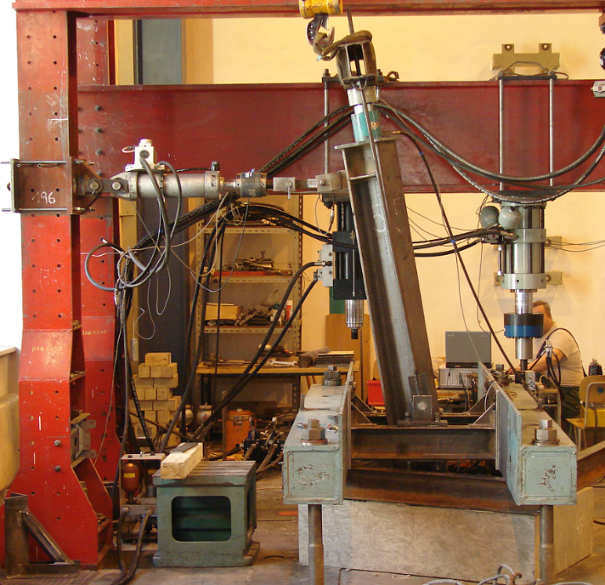
Experiment´s general data
Column HEB 240
Concrete block 1000x1200x9000 C20/25
Base plate 330x440x20 S235
Anchor bolts 4 x M20
Grout 30 mm
Bending of set up in biaxial bending

Slide 56
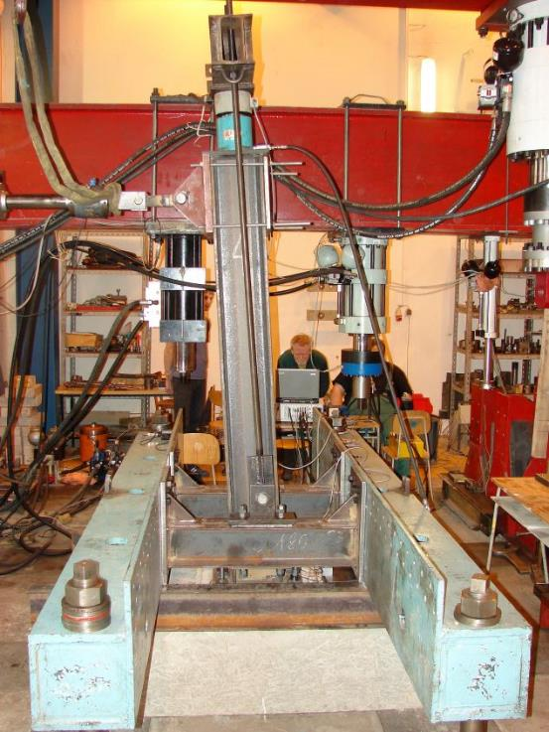
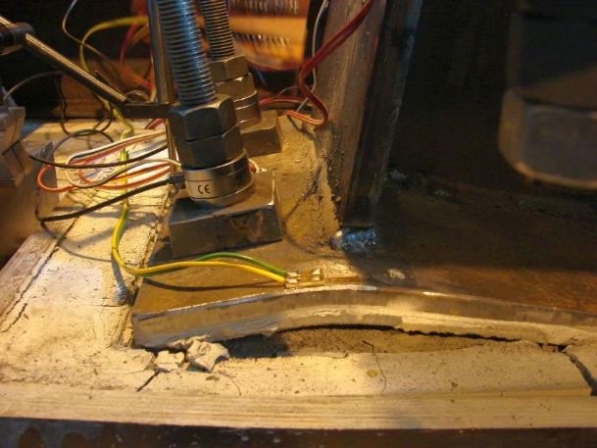
Behaviour of base plate in case of uniaxial bending
Deformed base plate
Set up in uniaxial bending

Slide 57
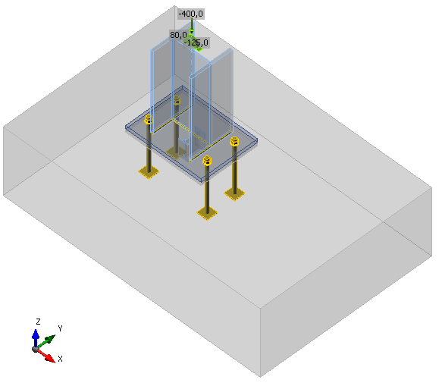
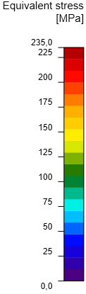
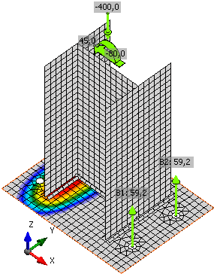
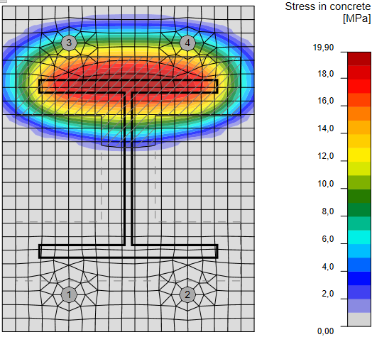
FE prediction of column base behaviour in uniaxial bending
Figure below shows the equivalent stresses in base plate and in concrete calculated by CBFEM.

Slide 58
Validation of models to experiments in uniaxial bending
Figure left shows on moment rotation diagram a good prediction capacity
of resistance of both Component (CM) and Component Based FE model (CBFEM).
CBFEM compared to CM predicts higher resistance. It includes real space stress in concrete.
The bending stiffness of experiments is lower compared to prediction.
The predictive model shows compared to experiments the safety due to conservative proposal of anchor bolt.
Notes:
Design model – design values of yield strength etc.
Concrete failures not taken into account

Slide 59
Validation of CBFE model to experiment in uniaxial bending
Figure left shows on anchor force – bending moment diagram a good prediction capacity
of Component Based Finite Element Model.
The predicted bolt force is conservatively higher compared to measured ones on both experiments.
Notes:
Seems that base plate yields later and the anchors are less stiff in reality

Slide 60
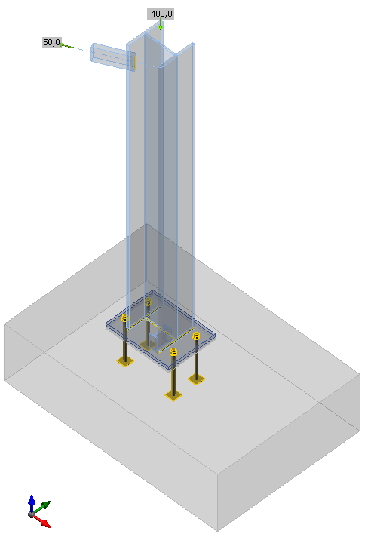
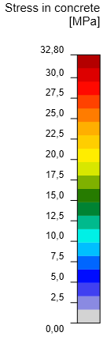
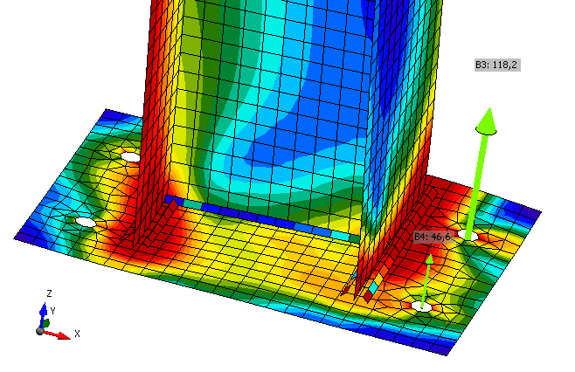
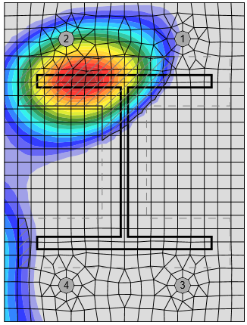
FEA model for column base in biaxial bending
Figure below shows the equivalent stresses
in base plate and in concrete in Component Based FE model

Slide 61
Validation of model to experiments in biaxial bending
Figure left shows on moment rotation diagram a good prediction capacity of resistance
of Component Based FE model.
The bending stiffness of experiments is lower compared to prediction.
The predictive model shows compared to experiments the safety due to a conservative proposal of anchor bolt.
Notes:
Design model – design values of yield strength etc.
Concrete failures not taken into account

Slide 62
Validation of CBFE model to experiment in uniaxial bending
Figure left shows on the anchor forces – bending diagram a good prediction capacity of Component Based FE model for the most loaded anchor bolt.
The predicted bolt force is conservatively higher compared to the measured ones.
Notes:
Seems that base plate yields later and the anchors are less stiff in reality

Slide 63
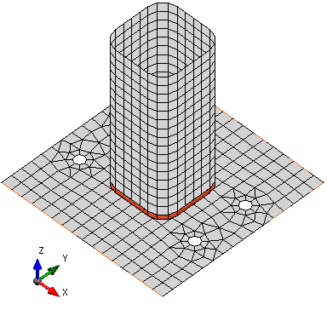
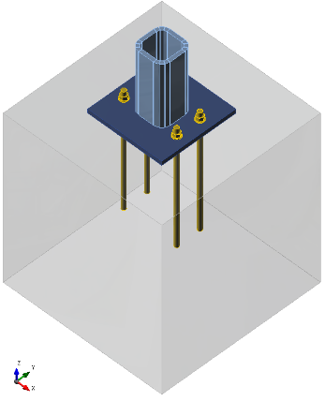
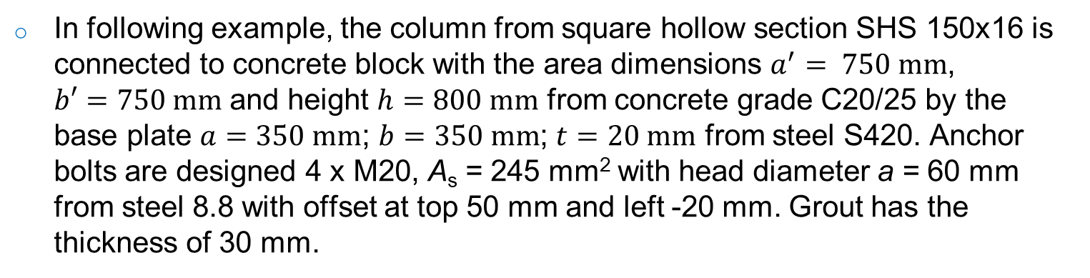
Verification column base for SHS 160
In following example, the column from square hollow section SHS 150x16 is connected to concrete block with the area dimensions $a^{′}= 750 mm$,
$b′=750 mm$ and height $h=800 mm$ from concrete grade C20/25 by the base plate $a=350 mm$; $b=350 mm$; $t=20 mm$ from steel S420. Anchor bolts are designed 4 x M20, A_{s} = 245 mm² with head diameter a = 60 mm from steel 8.8 with offset at top 50 mm and left -20 mm. Grout has the thickness of 30 mm.

Slide 64
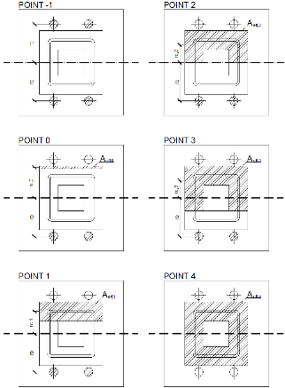
Bending moment – normal force interaction diagram
The resistance of column base predicted by CBFEM is compared to CM on moment – normal force interaction diagram for base plate 10 mm in Figure below.

Slide 65
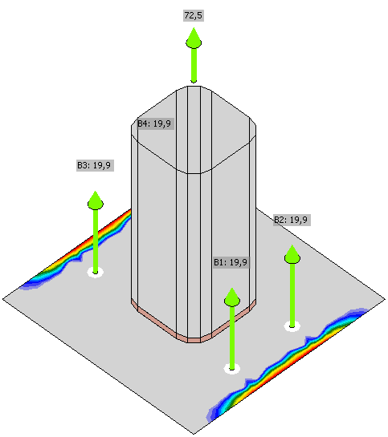
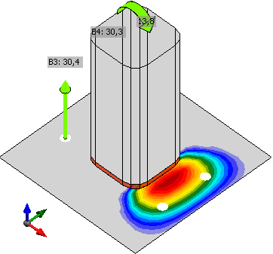
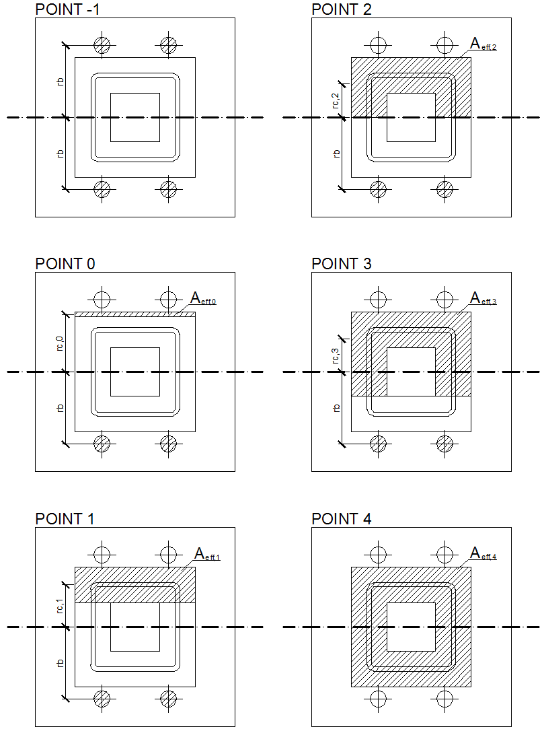
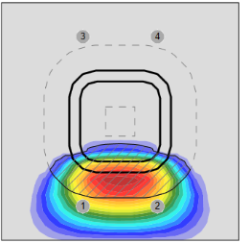
Significant points on the bending moment – normal force interaction diagram
The equivalent stresses at the edge of the thin base plate (10 mm) loaded in pure tension show the plate contact and possible development of prying forces.
Pure tension Pure bending

Slide 66




Significant points on the bending moment – normal force interaction diagram
The equivalent stresses and the design effective area of the contact of base plate to concrete block.
Flange in compression Half of cross section in compression

Slide 67




Significant points on the bending moment – normal force interaction diagram
The equivalent stresses and the design effective area of the contact of base plate to concrete block.
Webs in compression Pure compresion

Slide 68
Verification for pure compression
The resistance of column base predicted by CBFEM is compared to resistance predicted by CM in case of pure compression in Figure below.
The graph shows similar prediction capability of both methods.

Slide 69
Verification for pure bending
The resistance of column base predicted by CBFEM is compared to resistance predicted by CM in case of pure bending in Figure below.
The graph shows similar prediction capability of both methods. CBFEM predicts a bit higher resistance due to taking into account prying forces.

Slide 70
Sensitivity study base plate thickness;
10; 20; 30 mm
The resistance of column base predicted by CBFEM is compared to CM on moment – normal force interaction diagram for base plates 10 mm, 20 and 30 mm in Figure below.
CM
CBFEM

Slide 71

Open section column loaded in compression
Inputs
  Column, cross section HEB 240, steel S235
  Base plate, thickness 20 mm, offsets top 100 mm, left 45 mm, steel S235
  Concrete block, concrete C20/25, offset 335 mm, depth 800 mm, grout thickness 30 mm, grout quality C20/25
  Anchor bolt, M20 8.8
Output
  Axial force resistance F_{j.Rd} = -1744,2 kN

Slide 72

Hollow section column loaded in compression and bending
Inputs
  Column cross section: SHS 150/16, steel S460
  Base plate: thickness 20 mm, offsets at top 100 mm, on left 100 mm, welds 8 mm, steel S460
  Anchor bolts: M20 8.8., anchoring length 400 mm, offsets top layers 50 mm, left layers -20 mm, shear plane in thread
  Foundation block: concrete C20/25, offset 200 mm, depth 800 mm, shear force transferred by friction
  Grout thickness 30 mm
  Loading
    Axial force N = -913 kN
    Bending moment M_{y} = 62,1 kNm

Slide 73

Hollow section column loaded in compression and bending
Outputs
  Plate $ε=0,3 \%$;
  Anchor bolts 99,7 % ($N_{Ed}=30,3 kN≤N_{Rd,c}=30,4 kN$
  (critical component concrete cone breakout)
  Welds 57,7 %
  ($σ_{Ed}=239.9 MPa≤σ_{Rd}=416 MPa$)
  Concrete block 83,0 %
  ($σ=33,4 MPa≤f_{jd}=40 MPa$)
  Secant rotational stiffness $S_{js}=7,4\frac{MNm}{rad}$

Slide 74
Assessment III
How is limited in CBFEM the resistance of base plate?
How is modelled in CBFEM for column base design the concrete block?
Which part under base plate is considered in roe resistance?
How is limited the design of anchor bolts?
What is difference between design of column base and concrete column in compression?
What is the reason for higher resistance of column base in tension with base plate in failure mode 1-2?

Slide 75
Summary
Lecture 4
Column base

Slide 76
Summary
The column bases are designed with plastic distribution of forces under the base plate.
Concrete in compression under the base plate is designed considering its spatial stress.
The homogeneous stress under the flexible base plate is expected for the elastically deformed base plate.
Column bases are often subjected to the interaction of normal force and bending moment.

Slide 77
Summary
If more rows of anchor bolts are activated, only steel failure of anchor bolts is allowed to ensure ductile failure.
In the component method, prying of the anchor bolts is limited to failure mode 1-2.
In CBFEM, prying forces are taken into account when determining the bearing capacity, and if the anchorage to concrete is strong enough, the predicted resistance may be higher.

Slide 78





What is the major reason for using CBFEM for column bases?
Generally loaded complex column base is very difficult to design by Component Method.
The example of design by CBFEM is shown below.
Strain
Resistance limited
by anchor bolt failure
  Strain 3,4 %
  Prying forces are taken into account
Foot print Stress

Slide 79
Thank your for attention
URL: steel.fsv.cvut.cz
František Wald, Martin Vild, Marta Kuříková, Abhishek Ghimire,
Luboš Šabatka, Jaromír Kabeláč, Drahoš Kojala

Slide 80
Notes to users of the lecture
Subject Design of column bases of steel structures.
Lecture duration 60 mins
Keywords Civil Engineering, Structural design, Steel structure, Column base, Steel to concrete connection, Joint, Component Method, Component based Finite Element Method, Anchor bolts, Eurocode.
Aspects to be discussed Design of anchor bolts, Reasons and methods of classification, Principles of CM, Components in column base for CM, Components in column base for CBFEM, Principles of CBFEM, Spatial stresses in concrete block, Model of stress distribution under the base plate.
Further reading relevant documents in references and relevant European design standards, Eurocodes including National Annexes.
Preparation for tutorial exercise see examples in References.

Slide 81

Sources
Bajer M., Vild M., Barnat J., Holomek J., Influence of Selected Parameters
on Design Optimisation of Anchor Joint, in Steel, Space and Composite
Structures, Singapore, 2014,149–158.
Kuhlman U., Krimpmann M., Hofmann J., Wald F., et al, Design of steel-to-concrete joints, Design manual II, ECCS Brussels, 2013.
Steenhuis M., Wald F., Sokol Z., Stark J.W.B., Concrete in Compression and Base Plate in Bending, Heron, 2008, 53, 1/2, 51-68.
Wald F. et al, Benchmark cases for advanced design of structural steel connections, Česká technika ČVUT, 2016.
Wald F., Gödrich L., Šabatka L., Kabeláč J., Navrátil J., Component Based Finite Element Model of Structural Connections, in Steel, Space and Composite Structures, Singapore, 2014, 337-344.
Wald F., Sokol Z., Steenhuis M., Jaspart, J.P., Component Method for Steel Column Bases, Heron, 53, 2008, 3-20.
Wald F., Sokol, Z., Jaspart J.P., Base Plate in Bending and Anchor Bolts in Tension, Heron, 2008, 53, 1/2, 21-50.

Slide 82
Standards
CEN/TR 17081:2018 Design of fastenings for use in concrete - Plastic design of fastenings with headed and post-installed fasteners, CEN, Brussels, 2018, ready for release.
EN1992-1-1:2006, Eurocode 2, Design of concrete structures, Part 1-1, General rules and rules for buildings, CEN, Brussels, 2006.
EN1992-4:2018 Eurocode 2, Design of concrete structures – Part 4: Design of fastenings for use in concrete , CEN, Brussels, 2018, ready for release.
EN1993-1-8:2006, Eurocode 3, Design of steel structures, Part 1-8, Design of joints, CEN, Brussels, 2006.
EN1994-1-1:2010, Eurocode 4, Design of composite steel and concrete structures, Part 1-1, General rules and rules for buildings, CEN, 2010.
ETAG 001: 2010, Guideline for European Technical Approval of Metal Anchors for Use in Concrete – Annex C: Design Methods for Anchorages, Brussels, EOTA, 2010.

Slide 83
The standards related to anchor bolts
Till the end of last century were anchor bolts designed according to experimental results summarised in design tables.
Majority or current standards for anchorages to concrete are based on failure mode method, Concrete capacity design method, developed by prof. R. Eligehausen and his students at University of Stuttgart, see Eligehausen R., Mallée R., Silva J. F., Anchorage in concrete construction, Ernst & Sohn, 2006.
Currently is used in Europe for design Annex C in ETAG 001:2010 Metal anchors for use in concrete, https://www.eota.eu/en-GB/content/etags-used-as-ead/26/.
Prestandard prEN 1992-4 was published in 2010 and valid for three years. In 2018 is expected to be published EN 1992-4:2018, which will replace Annex C in ETAG 001.
American and Canadian standards are nearly identical. American standard ACI 318 used to contain anchorage design in Annex D. In the version from the year 2014 is described in Ch.17. Canadian standard A23.3 contains anchorage design in Annex D.
Australian standard SA TS 101:2015 is fully compatible with ETAG, http://www.aefac.org.au.

