Slide 1
Connection design by Component Based Finite Element Method
Lecture 3
Joint of hollow to open section

Slide 2
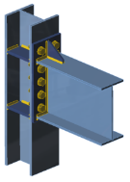
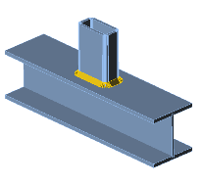
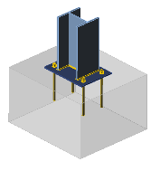
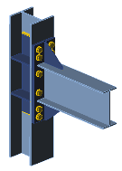
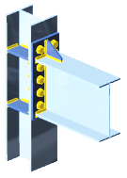
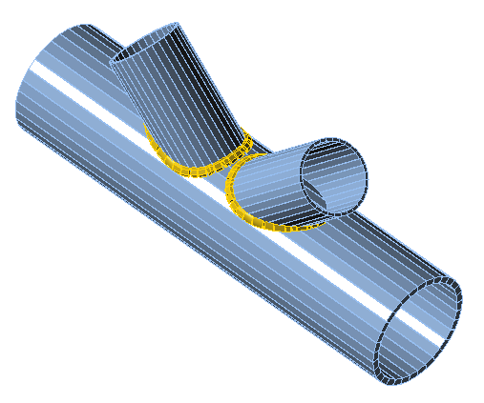
List of lectures
Beam to column moment connection
Hollow section joints
Joint of hollow to open section
Column base
Seismically qualified joints
Joints at elevated temperature

Slide 3
Aims and objectives
Provide information on modeling hollow section connections
Provide an online training to students and engineers
Illustrate the differences between numerical simulation and numerical calculation, e.g., between research-oriented FEM and design-oriented FEM.
Show the process of Validation & Verification
Offer a list of references relevant to the topic

Slide 4
Lecture 4
Joint of hollow to open section
František Wald, Marta Kuříková, Martin Kočka, Abhishek Ghimire,
Lubomír Šabatka, Jaromír Kabeláč, Drahoš Kojala

Slide 5

Tutorial
This lecture describes the principles of FEM modeling of hollow section joints using Component Based FEM (CBFEM).
Failure mode models are presented for one of the simplest cases on hollow to open section joints.
An overview of both simple and FEM analysis and modeling is presented.
Validation, verification and benchmark cases using Component Based Finite Element Method are presented.
Material was prepared under the R&D project MERLION II
supported by Technology Agency of the Czech Republic, project No TH02020301.

Slide 6
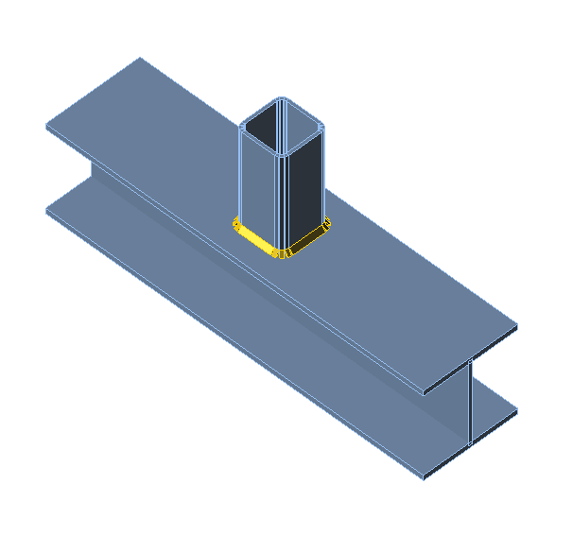
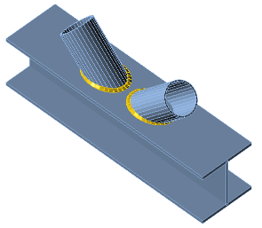
Motivation
The purpose of this lecture is to explain the design of connections of hollow sections to open sections, as a simple case of a very large subject.

Slide 7
Outline of the lecture
Introduction - hollow section joints
Failure mode method
  General
  Influencing joint parameters
  Component method
  Hollow to open joints
  Assessment I
Component based FE method
  Principles
  Validation
  Verification
  Benchmark case
  Assessment II
Summary

Slide 8
Hollow section joints
Lecture 4
Joint of hollow to open section

Slide 9
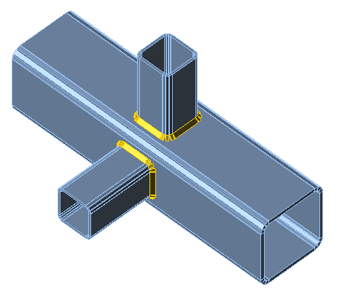
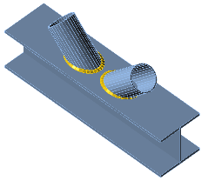
Geometry
The welded joints of circular, square or rectangular hollow sections can be either:
  Uni-planar
  Multi-planar
The combination of hollow sections
with open sections are used
in the uni-planar joints.

Slide 10
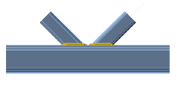
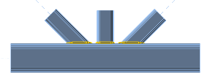
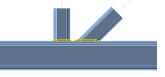
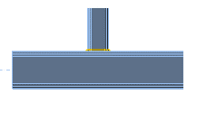
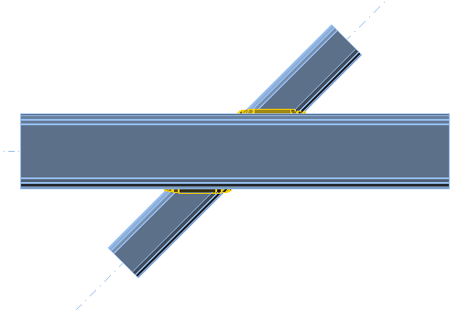
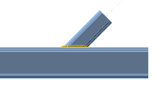
Basic geometrical types
  The typical uni-planar joints
K joint
KT joint
N joint
T joint
X joint
Y joint

Slide 11
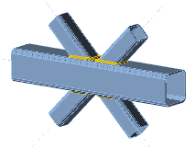
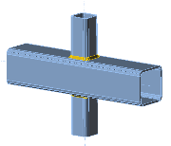
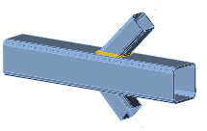
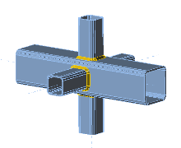
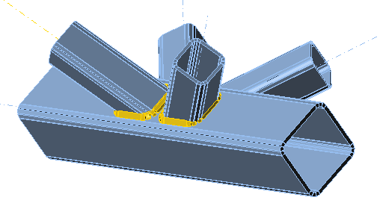
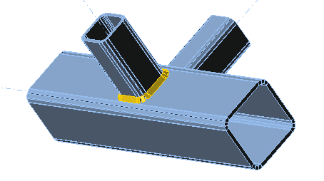
Basic geometrical types
  The typical multi-planar joints
DK joint
X joint
DY joint
KK joint
TT joint
XX joint

Slide 12
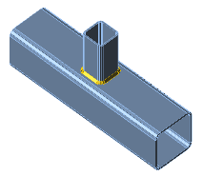
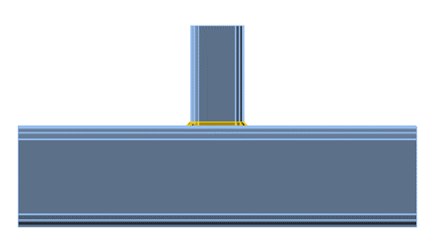
Loading
The design resistance of the joint is expressed as maximum axial or moment resistances for the brace.
The moment resistance can be reached for in-plane or out-of-plane loading.
N_{Ed}
N_{Ed}
M_{ip,Ed}
M_{ip,Ed}
M_{op,Ed}

Slide 13
Design of welds
The welds are preferably designed for full resistance of joint not be the weakest part. I.e. the design resistance of the weld, per unit length of perimeter of a brace member, should not normally be less than the design resistance of the cross-section of that member per unit length of perimeter.
The full seam butt weld is recommended for t_{i} > 8 mm
with a = t_{i}
The fillet welds are recommended only for members thickness t_{i}  8 mm
with the weld effective thickness a for element thickness t_{i} and for steel
  S 235 as a = 0,92 t_{i}
  S 275 as a = 0,96 t_{i}
  S 355 as a = 1,10 t_{i}
  S 420 as a = 1,42 t_{i}
  S 460 as a = 1,48 t_{i}

Slide 14
Design methods
Design resistance of joints may be determined by:
Failure mode method based on
  Curve fitting procedures with derived joint parameters based on analytical models
Component method
  Using lever arms and component resistances determined according to a failure mode procedure
Finite element method

Slide 15
Finite element method
  Research oriented model by numerical experiments with geometric and material non-linear analysis with imperfections and evaluation of safety as mechanical experiments according to EN1990.
  Design oriented model with geometric and material non-linear analysis using design material model.
      The Component based FEM (CBFEM) is design procedure combining
      analytical models for components and FE analysis of plates.

Slide 16
Failure mode model
Lecture 4
Joint of hollow to open section

Slide 17
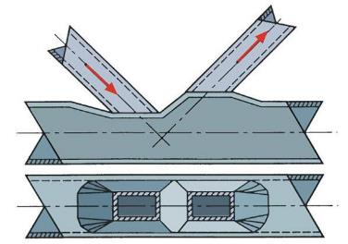
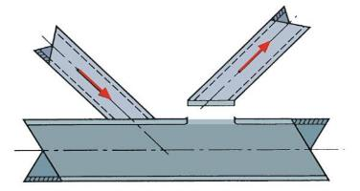
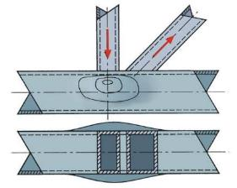
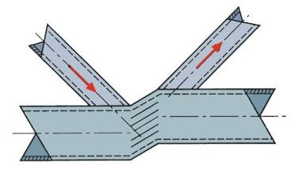
Failure modes on chord demonstrated on rectangular hollow sections (RHS)
Punching shear failure of the chord face
Chord face failure
Overall shear failure of the chord
Chord side wall failure

Slide 18
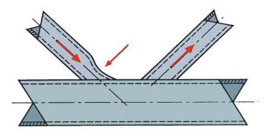
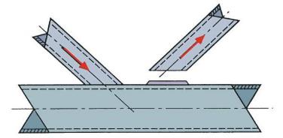
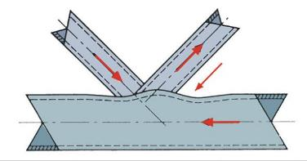
Failure modes on brace demonstrated on rectangular hollow sections (RHS)
Brace failure
Local buckling
of the brace member
Local buckling of the chord face

Slide 19
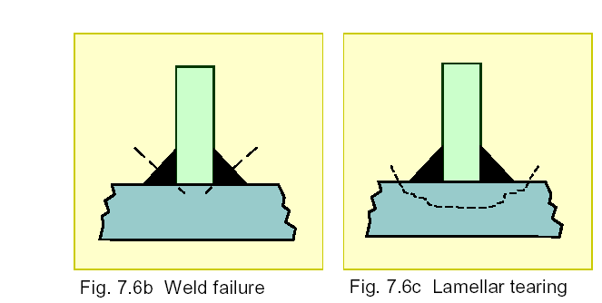
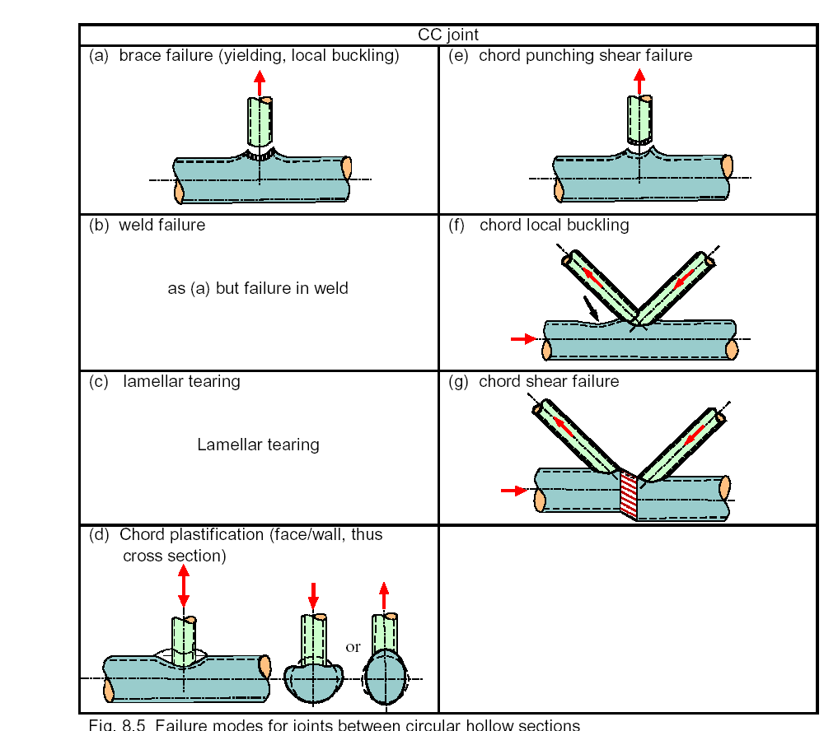
Excluded modes of failure
Weld failure
  Excluded by use efficient throat thickness of the welds
Lamellar tearing
  Excluded by material properties
Local buckling of the chord or brace sections
  Excluded by using sections with can be classified
  to a maximum cross section class 2

Slide 20
Design principle
Welds are designed for full sectional resistance.
Geometrical types are selected.
Range of validity is prepared based on available experiments for each geometrical type.
Limited number of failure modes is possible by each geometrical type.
For each geometrical type is prepared for each failure mode a curve fitting prediction of resistance.
The influencing joint parameters are derived based on five analytical models.

Slide 21
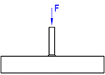
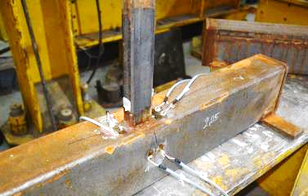
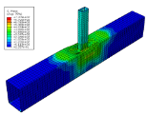
Experiments and design resistance by curve fitting procedures
The design resistance is derived from experiments from
  Ultimate load (in EN1993-1-8:2005)
  Deformation limit (in prEN1993-1-8:2017)
    chord width as b₀/300
Experiment
Model
EN3-1-8:2006
Model
EN3-1-8:2021
  Example behaviour and curve fitting predictions of joint with RHS chord 150 x 100 x 4 mm and brace 50 x 30 x 4 mm

Slide 22
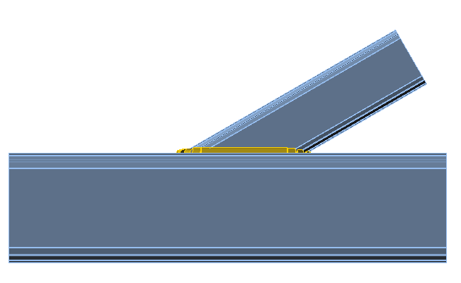
General limits of application
The members of lattice structures should satisfy the requirements:
Class 1 (or Class 2) cross-section only
The angle between the brace and the chord should be larger than 30°
θ ≥ 30°

Slide 23
Analytical Models for determination of influencing joint parameters
The curve fitting procedure is used for evaluation of joint´s resistance on each possible failure mode.
For the determination of the influencing joint parameters of welded joints between rectangular hollow sections are used analytical models:
  Yield line
  Punching shear
  Brace effective width
  Chord side wall bearing or buckling
  Chord shear

Slide 24
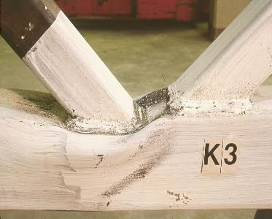
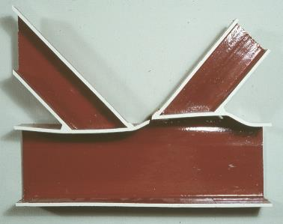
Yield line model for the influencing joint parameters
The typical case of searching for influencing parameters by yield line model is chord face failure, as is shown below on deformed shape of K joint of RHS after experiment and its cut.

Slide 25
Geometry of K shape joint of rectangular hollow section
In principle, the yield line model is an upper bound approach
N₂
N₁
g
Θ₁
Θ₂
d
d
h₀
κ_{i}
b₁
b₀
l_{i}
α
Various yield line pattern have to be examined in order to obtain the lowest capacity
Strain hardening effects and membrane action not considered

Slide 26
Limits of application of Yield line model
For joints with
small β ratios the deformations may be too high to realise the yield line pattern
medium β ratios the yield line model gives a good estimate of the chord face plastification capacity
high β ratios prediction of an infinite strength
where β is the ratio of the mean diameter or width of the brace members, to that of the chord.
For T, Y and X joints it is
d₁/d₀; d₁/b₀ or b₁/b₀.
brace diameter/chord diameter; brace diameter/chord width or brace width/chord width

Slide 27
Geometry of punching shear model for the influencing joint parameters
Very small gap
N₁
h₁
Θ₁
t₀
g = b₀ – b₂
0,5·b_{e,p}
0,5·b_{e,p}
Big gap
h₁/sinΘ₁
h₂ / sinΘ₂

Slide 28
Punching shear model for the influencing joint parameters
Punching shear is caused by the brace load component perpendicular to the chord face.
Since of the non-uniform stress distribution at connection and not sufficient deformation capacity may be available, only parts of connection perimeters are effective for punching shear failure.
Therefore the punching shear criterion is

Slide 29
Brace effective width model for the influencing joint parameters
Similar to punching shear failure but the complete brace load has to be taken into account.
For a T, Y and X joint,the effective width
criterion is
N₁ = f_{y1} t₁ (2h₁+2b_{e}– 4t₁)
As for punching shear failure the gaps are important for the effective lengths.
h₁
N₁
0,5·b_{eff}
Θ₁

Slide 30
Brace effective width model for the influencing joint parameters
For K-joints with gaps in the allowed range the brace effective width criterion is
N₂ = f_{y2} t₂ (2h₂+b₂+b_{e}– 4t₁)
No regulations for small gaps available
For big gaps the criterion for T-, Y- and X-joints can be used

Slide 31
Chord side wall bearing/buckling model for the influencing joint parameters
T, Y and X joints with a high β ratio generally fail by yielding or buckling of the chord side walls.
For joints with β = 1,0 the yield capacity of the chord webs is determined as
h₁
N₁
b₁
Θ₁
2,5·t₀
t₀
2,5·t₀
t₁
h₀
t₀
h₁/sinΘ₁ +5t₀
b₀

Slide 32
Chord side wall bearing/buckling model for the influencing joint parameters
For slender walls the yield stress f_{y0} is replaced by a buckling stress f_{k} which is obtained from the European buckling curve a
For a Euler strut with a buckling length of h₀ - 3t

Slide 33
Chord shear model for the influencing joint parameters
N_{i,Rd}
g
Θ₁
V
N_{0,gap}
N_{0,gap}
M
h₀
A_{V}
M
t₀
V
b₀
Resistance is calculated
based on the basic formulae for plastic design.

Slide 34
Chord shear model for the influencing joint parameters
The plastic shear load capacity is
with an effective shear area
A_{V} = (2h₀ + α ∙ b₀) t₀
Based on
the Huber Hencky-Von Mises criterion the following interaction formula for shear resistance of the chord web
h₀
A_{V}
t₀
b₀

Slide 35
Component based approach for hollow section joints
Lecture 4
Joint of hollow to open section

Slide 36
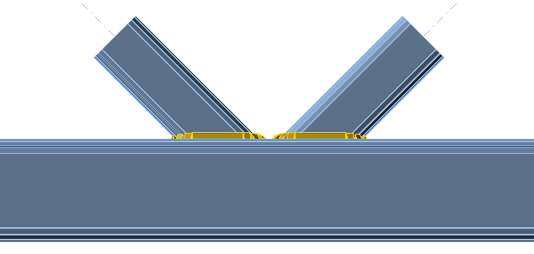
Principle
Component based approach for hollow section design is formal reorganisation of equations to be engineering user friendly.
Failure modes are represented as components.
The same equations are used by curve fitting approach but in different formulation.
Joint configuration
Joint 2
Joint 1
Brace 2
Brace 1
θ₂
θ₁
Chord

Slide 37
Defined lever arms and components (failure modes)
k_{fa} factors transferred to
  b_{eff} effective widths
  r_{a} lever arm
The interaction of load limits the application.

Slide 38
7 failure modes are modelled as 7 components
Chord face in bending
Chord side wall
in tension/ compression
Chord side wall in in shear
Chord face under punching shear
Brace flange and web
in tension/compression

Slide 39
Application of principles to hollow to open joints
Lecture 4
Joint of hollow to open section

Slide 40
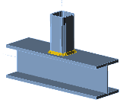
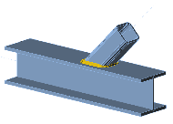
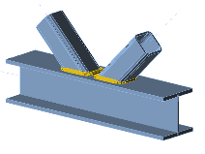
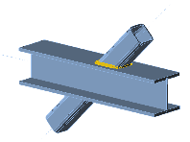
Hollow to open joints as example of application
Types of joint available in failure mode method
  T, Y, X, K and K gap joint
Two failure modes only
  Brace failure
  Chord web failure
  Chord shear failure (only for K joint)
Range of validity
  Class 1 and 2 with limited flange width
Influencing parameters
  b_{eff} brace effective width
  b_{w} chord web effective width
T joint
Y joint
K joint
X joint

Slide 41
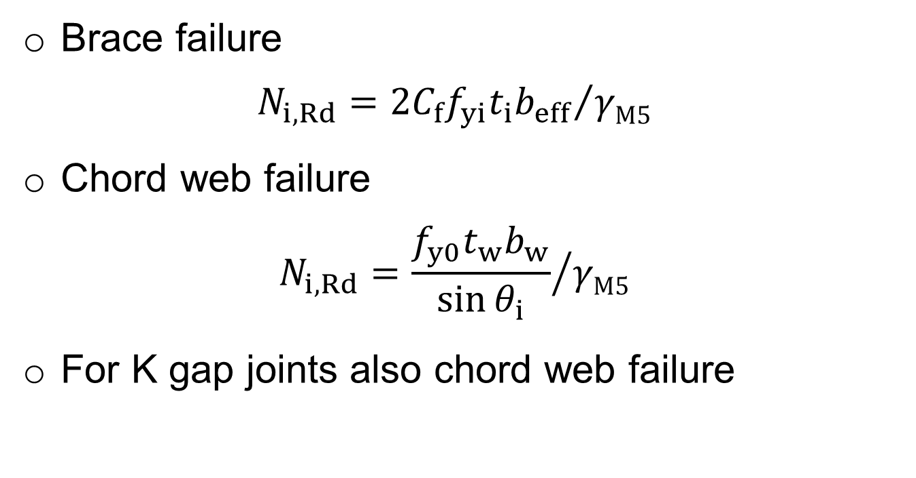
Design resistance of welded joints between RHS or CHS brace members and I or H section chords by failure mode method
Brace failure
$$N_{i,Rd}={2C_{f}f_{yi}t_{i}b_{eff}}/{{γM5}_{}}$$
Chord web failure
$$N_{i,Rd}={\frac{f_{y0}t_{w}b_{w}}{\sin{θ_{i}}}}/{{γM5}_{}}$$
For K gap joints also chord web failure

Slide 42
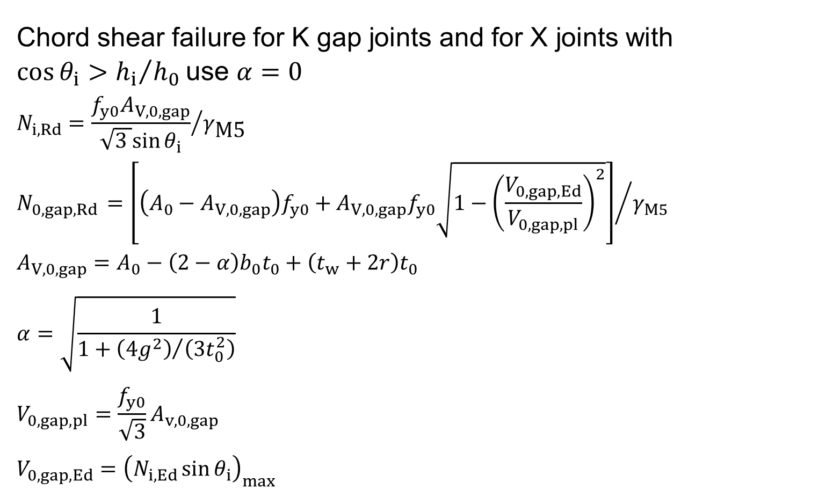
Design resistance of welded joints between RHS or CHS brace members and I or H section chords by failure mode method
Chord shear failure for K gap joints and for X joints with $\cos{θ_{i}>{h_{i}}/{h_{0}}}$ use $α=0$
$$N_{i,Rd}={\frac{f_{y0}A_{V,0,gap}}{\sqrt{3 }sin{θ_{i}}}}/{γ_{\text{M}\text{5}}}$$
$$N_{0,gap,Rd} {=\left[\left(A_{0}−A_{V,0,gap}\right)f_{y0}+A_{V,0,gap}f_{y0}\sqrt{1−{\left(\frac{V_{0,gap,Ed}}{V_{0,gap,pl}}\right)}^{2}}\right]}/{γ_{M5}}$$
$$A_{V,0,gap}=A_{0}−\left(2−α\right)b_{0}t_{0}+\left(t_{w}+2r\right)t_{0}$$
$$α=\sqrt{\frac{1}{1+{\left({4g}^{2}\right)}/{\left(3t_{0}^{2}\right)}}}$$
$$V_{0,gap,pl}=\frac{f_{y0}}{\sqrt{3}}A_{v,0,gap}$$
$$V_{0,gap,Ed}={\left(N_{i,Ed}\sin{θ_{i}}\right)}_{max}$$

Slide 43
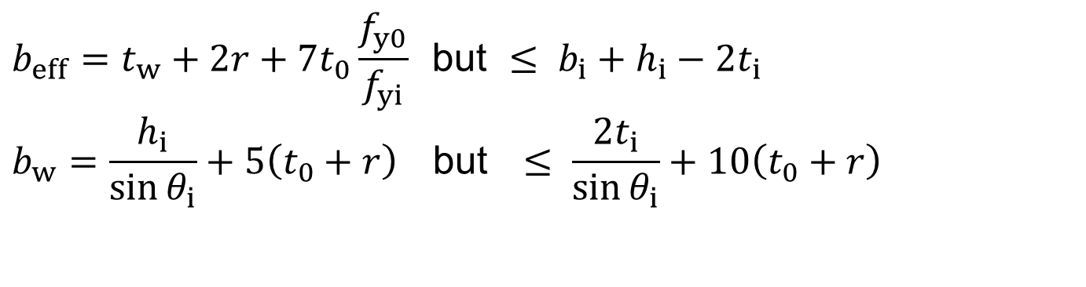
Effective width of welded joints between RHS or CHS brace members and I or H section chords for failure mode method
For RHS braces
$$b_{eff}=t_{w}+2r+{7t}_{0}\frac{f_{y0}}{f_{yi}} \text{but} ≤ b_{i}+h_{i}−{2t}_{i}$$
$$b_{w}=\frac{h_{i}}{\sin{θ_{i}}}+5\left(t_{0}+r\right) \text{but} ≤ \frac{{2t}_{i}}{\sin{θ_{i}}}+10\left(t_{0}+r\right)$$

Slide 44
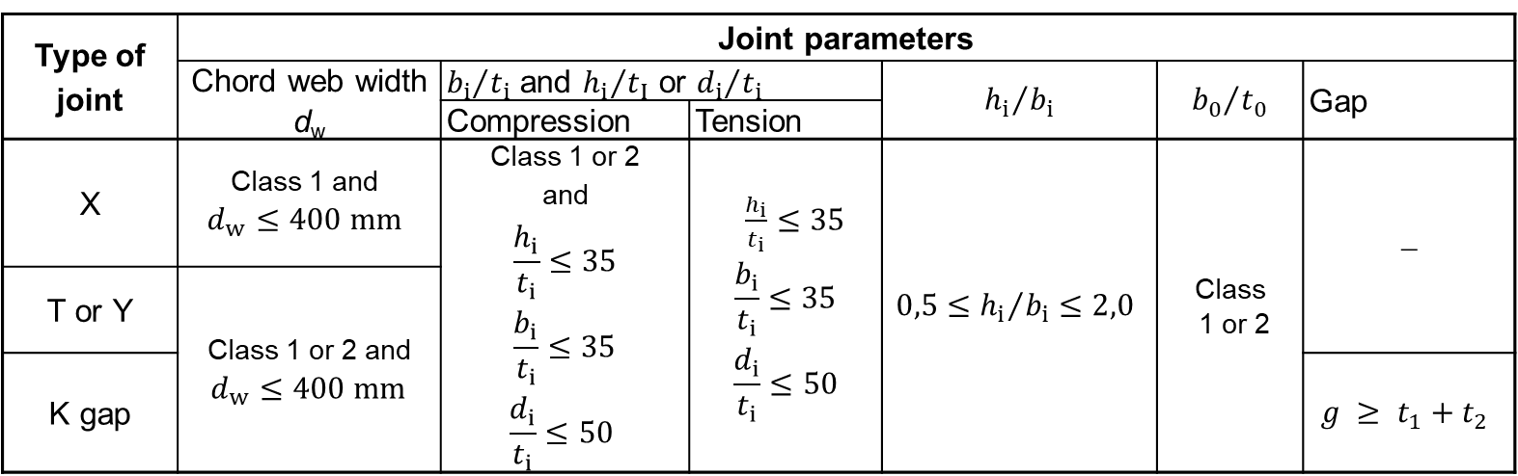
Range of validity for welded joints between CHS or RHS brace members and I or H section chord members for failure mode method
Type of joint | Joint parameters
 | Chord web width d_{w} | ${b_{i}}/{t_{i}}$ and ${h_{i}}/{t_{I}}$ or ${d_{i}}/{t_{i}}$ |  | $${h_{i}}/{b_{i}}$$ | $${b_{0}}/{t_{0}}$$ | Gap
 |  | Compression | Tension
X | Class 1 and $$d_{w}≤400 mm$$ | Class 1 or 2 and $$\frac{h_{i}}{t_{i}}≤35$$ $$\frac{b_{i}}{t_{i}}≤35$$ $$\frac{d_{i}}{t_{i}}≤50$$ | $\frac{h_{i}}{t_{i}}≤35$ $$\frac{b_{i}}{t_{i}}≤35$$ $$\frac{d_{i}}{t_{i}}≤50$$ | $$0,5≤{h_{i}}/{b_{i}≤2,0}$$ | Class 1 or 2 | −
T or Y | Class 1 or 2 and $d_{w}≤400 mm$
K gap |  |  |  |  |  | $$g ≥ t_{1}+t_{2}$$

Slide 45

Component approach of welded joints between RHS or CHS brace members and I or H section chords by failure mode method
Brace failure from failure mode method
$$N_{i,Rd}={2C_{f}f_{yi}t_{i}b_{eff}}/{γ_{\text{M}\text{5}}}$$
$$b_{eff}=t_{w}+2r+{7t}_{0}\frac{f_{y0}}{f_{yi}} \text{but} ≤ b_{i}+h_{i}−{2t}_{i}$$
$$\text{can} \text{be} \text{overwritten} \text{for} \text{component} \text{method} \text{as}$$
$$F_{e,Rd}={C_{f}f_{yi}t_{1}b_{eff}}/{γ_{\text{M}\text{5}}}$$
$$N_{1,Rd}=4[F_{N,min, Rd}]$$
$$b_{eff,e}=0,5b_{eff}$$

Slide 46
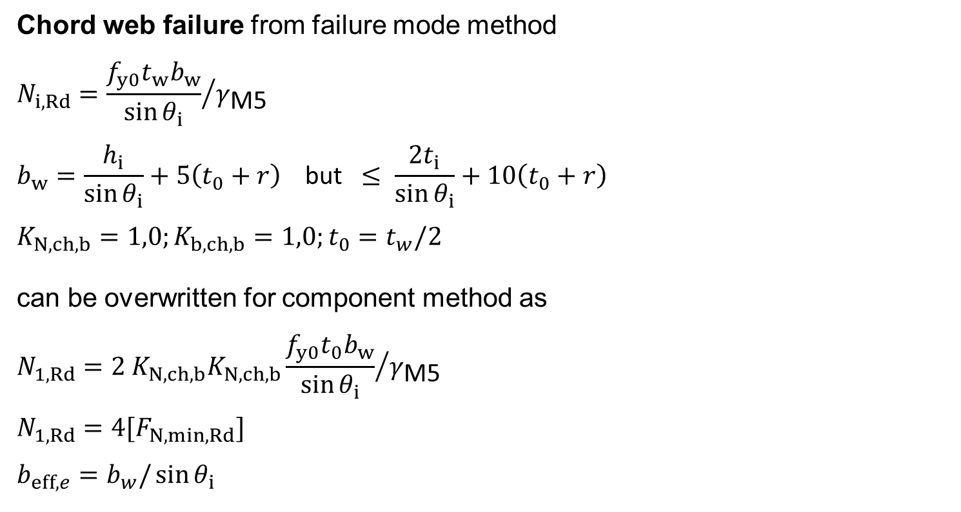
Component approach of welded joints between RHS or CHS brace members and I or H section chords by failure mode method
Chord web failure from failure mode method
$$N_{i,Rd}={\frac{f_{y0}t_{w}b_{w}}{\sin{θ_{i}}}}/{γ_{\text{M}\text{5}}}$$
$$b_{w}=\frac{h_{i}}{\sin{θ_{i}}}+5\left(t_{0}+r\right) \text{but} ≤ \frac{{2t}_{i}}{\sin{θ_{i}}}+10\left(t_{0}+r\right)$$
$$K_{N, ch, b}=1,0;K_{b, ch, b}=1,0;t_{0}=t_{w}/2$$
can be overwritten for component method as
$$N_{1,Rd}={2 K}_{N, ch, b}K_{N, ch, b}{\frac{f_{y0}t_{0}b_{w}}{\sin{θ_{i}}}}/{γ_{\text{M}\text{5}}}$$
$$N_{1,Rd}=4[F_{N,min, Rd}]$$
$$b_{eff,e}=b_{w}/\sin{θ_{i}}$$

Slide 47
Assessment I
What limits the application of the component method to the design of hollow section connections?
How are the analytically derived parameters applied in the failure mode design procedure?
Which failure modes are excluded and how?
Why are validity ranges used?
Is the failure mode method the curve fitting method?
What is the principle of the component method prepared on the basis of the failure mode method?
What failure modes can be observed at joints between hollow and open sections?

Slide 48
Component Based
Finite Element Method
Lecture 3
Joint of hollow to open section

Slide 49
Material
Bilinear ideal elastic plastic diagram is used in design oriented models as CBFEM according to Ch. 7 in EN 1993-1-5:2006 and the slope of plastic branch is due to numerical stability E/1000.
Plastic strain in plates is limited by 5%.
In research oriented models is calculated the true stress-strain diagram from the material properties obtained in tensile tests, which is taking into account the necking of the coupon during its yielding before rupture.

Slide 50



Plate and cross sections
For modelling of plate are applied four node quadrangle shell elements with six degrees of freedom.
I.e. there are three translations and three rotations in every node.
The cross section is build from plates with independent meshes, which are connected by constraints, to simplify the meshing procedure.

Slide 51

Welds
Filled weld is modelled by equivalent solid elastoplastic element, which is added between plates to express the weld behaviour, see Fig. below.
The element respects the weld throat thickness, position, and orientation to assure a good representation of weld deformation stiffness, resistance and deformation capacity.
The plastic strain in weld is limited to 5% as in basic material.
Equivalent stress
τ
σ
Weld throat section
Equivalent solid element
Multipoint constraint
Multipoint constraint
Wald et al. (2016)

Slide 52

Verification & Validation
The need and position of Verification & Validation in prediction of the reality is demonstrated on the diagram below
  ISO/FDIS 16730
  Fire safety engineering - Assessment, verification and validation of calculation methods, Geneva, 2008.

Slide 53



Design and research oriented model
Current approval of design models consist of
  Experiments
Research oriented FE model (ROFEM)
  Validated on experiments
  Numerical experiments
Design numerical model (DOFEM)
  Verified to numerical experiments and/or another design models
  Sensitivity study
  Validity range
Benchmark case (BC)
  To help the users of model to check up its correctness and proper use
Experiment
Research model
Design model

Slide 54




Experiments with
T joint of hollow to open section
In compression
In bending

Slide 55
Experiments in compression
Geometry
Failure modes
A3 - Brace failure A1 - Chord web failure

Slide 56

Results of experiments in compression

Slide 57
Research oriented FEM
ABAQUS 6.13
Solid quadratic element (20-node brick,
C3D20)
True stress-strain multilinear material model

Slide 58
Boundary conditions for research oriented FEM
Bottom flange boundary condition
  Rotation and translation restrain in all axis
Load point
  Coupling to top of braces edges

Slide 59
Validation of failure modes
Both failure modes
were well predicted
Failure of chord web, experiment A1
Failure of brace, experiment A2

Slide 60

Mesh sensitivity study
The Figure below shows the importance of the mesh size to the prediction of behaviour of joint

Slide 61


Description of local and global behaviour
Development of plastic zones
The first yielding
in the chord web
5% strain
Full plasticity
at the peak load

Slide 62
Quality of prediction of resistance
The validation should answer the quality of prediction on global behaviour namely in important points of design.
Table below shows the prediction of resistance by deformation of upper surface b₀/300 (used by curve fitting models) and 5% of strain (used by numerical models) for experiment in compression A1 with failure of chord web.

Slide 63


Verification of T-joint and K-joint
CBFEM model to failure mode procedure
A uniplanar T-joint and K-joint of a rectangular hollow section brace to an open section chord.
The brace section is RHS 140x70x10.
The chord sections are IPE, IPN, HEA a HEB.
The brace is loaded in tension/compression or by in-plane bending moment.

Slide 64


Verification of T-joint and K-joint in compression
The prediction by component based finite element method (CBFEM) is verified with the failure modes (FM) implemented in EN 1993-1-8:2005.
Three failure modes occur in joints of the welded rectangular hollow sections to the open sections, e.g. the local yielding of brace (brace failure), the chord web failure and the chord shear.

Slide 65
Verification of T-joint in bending
The prediction by component based finite element method (CBFEM) is verified with the failure modes (FM) implemented in EN 1993-1-8:2005.
Two failure modes occur in joints of the welded rectangular hollow sections to the open sections, e.g. the local yielding of brace (brace failure) and the chord web failure.

Slide 66



Benchmark case
Uniplanar T-joint between RHS brace and I chord
Input
  Chord: IPE270, Steel S235
  Brace: RHS 140x70x10, Steel S235
  Weld: Throat thickness a_{w} = 10 mm, Fillet weld around the brace
Output
  Design resistance in compression/tension F_{c,Rd} = 431 kN
  Collapse mode is full yielding of the chord web
Plastic strain [%]

Slide 67
Assessment II
How is modelled the material for research and how for design models?
What elements are recommended for plates?
How are modelled welds?
What is expected to be the accurate solution in mesh sensitivity study?
How differs validation from verification?
What are two major purposes of benchmark cases in application of FEA analyses?

Slide 68
Summary
Lecture 3
Joint of hollow to open section

Slide 69



Summary
The hollow sections to open sections joints belongs to family of hollow section joints.
There are three failure modes
  Brace failure
  Chord web failure
  Chord web shear failure in case of gap
Shear failure of the chord
Brace failure
Chord web failure

Slide 70
Summary
The curve fitting methods are used to evaluate design resistances for each possible failure mode.
The range of validity limits the application of the expressions to experimentally verified solutions only.
The component-based approach is a great simplification for the design of some rectangular hollow sections.
For design of circular hollow sections brings unpleasant complexity.
It cannot be used for complex joints in general.

Slide 71

Prediction of global and local behaviour
T joint of RHS brace and HEA chord
Chord HEA180
Brace RHS 180x100x8.8
Steel S355
Weld throat thickness 11 mm

Slide 72

Global and local behaviour
Elastic stage
M = 10 kNm
φ = 0,9 mrad
S_{j} = 10,7 MNm/rad

Slide 73

Global and local behaviour
Plastification of the upper flange of RHS brace
M = 19 kNm
φ = 1,8 mrad
S_{j} = 10,7 MNm/rad

Slide 74

Global and local behaviour
Initial plastification in the open section web
M = 21 kNm
φ = 2,0 mrad
S_{j} = 10,6 MNm/rad

Slide 75

Global and local behaviour
Initial plastification in the weld
M = 25 kNm
φ = 2,5 mrad
S_{j} = 10,0 MNm/rad

Slide 76

Global and local behaviour
Initial plastification in the open section flange
M = 33 kNm
φ = 4,4 mrad
S_{j} = 7,6 MNm/rad

Slide 77

Global and local behaviour
Initial plastification in the RHS brace roundings
M = 40 kNm
φ = 7,7 mrad
S_{j} = 5,3 MNm/rad

Slide 78

Global and local behaviour
Full plastification through the open section web
M = 47 kNm
φ = 18,8 mrad
S_{j} = 2,6 MNm/rad

Slide 79


Global and local behaviour
The open section web reaches plastic strain 5%
M = 48,5 kNm
φ = 25,4 mrad
S_{j} = 2,2 MNm/rad

Slide 80



What is the major reason of using CBFEM for Hollow section joints?
The design resistance of generally loaded complex hollow section joints may be by failure mode method only estimated.
The example of design procedure by CBFEM is shown below.
3D model
Finite element analyses
Design check

Slide 81



Design tips
The most economical and common way to connect hollow sections to open sections is by direct connection, without the use of cross plates or gussets, which is also the most efficient method for protection and maintenance.
Connections between hollow and open sections are easy to make because the connectors have only straight end cuts.

Slide 82


Design tips
Tips to optimize design
Select relatively stocky chord
Select relatively thin brace
t₁
b₁
b₀
t₀
b₁/b₀ as high as possible
t₁/t₀ as low as possible

Slide 83


Design tips
Tips to optimize joint design
Consider virtues of gapped K-connections
Gapped joints are easier and cheaper to fabricate.
Overlapped joints have higher static and fatigue strength and produce stiffer truss (reduced truss deflections).

Slide 84
Thank your for attention
URL: steel.fsv.cvut.cz
František Wald, Marta Kuříková, Martin Kočka, Abhishek Ghimire,
Luboš Šabatka, Jaromír Kabeláč, Drahoš Kojala

Slide 85
Notes to users of the lecture
Subject Design of hollow section joints of steel structures.
Lecture duration 60 mins.
Keywords Civil Engineering, Structural design, Steel structure, Trusses, Truss girder, Joint, Hollow section joint, Hollow to open section joint, Component Method, Component based Finite Element Method, Eurocode.
Aspects to be discussed Curve fitting models of joints, Failure mode models of joints, FE models of joints, Failure modes, Component method principle, Application of analytical modelling
Further reading relevant documents in references and relevant European design standards, Eurocodes including National Annexes.
Preparation for tutorial exercise see examples in References.

Slide 86

Sources
Batista P. N., Component based finite element model
of hollow to open section connection, Master theses,
Czech Technical University in Prague, 2017.
Jaspart J.P., Weynand K., Design of hollow section joints using the component method, Tubular Structures XV, 2015, 403-410.
Lu L.H., de Winkel G.D., Yu Y., Wardenier I., Deformation limit for the ultimate strength of hollow section joints, Tubular Structures VI, Balkema, Rotterdam, 1994, 341-347.
Wald F. et al, Benchmark cases for advanced design of structural steel connections, Česká technika ČVUT, 2016.
Wald, F.; Kočka, M. et al, To the advanced design models of hollow section joints, Stahlbau, Holzbau und Verbundbau, Stuttgart, 2017, 176-181Wardenier, J., Hollow section joints. Delft University Press, 1982, Delft.
Wardenier, J., Hollow section joints. Delft University Press, 1982, Delft.
Wardenier J. at al, Design Guide for Structural Hollow Sections in Mechanical Applications, CIDECT, Köln, 1995.
Wardenier, J., Packer, J.A., Vegte, G.J. van der, Zhao, X.-L., Hollow sections in structural applications, CIDECT, 2nd Edition, Bouwen met Staal, Delft, 2010.

Slide 87
References CIDECT
http://www.cidect.org/design-guides.html
https://www.aisc.org/technical-resources/cidect-design-guides/
Dutta, D., Wardenier, J. Yeomans, N., Sakae, K. Bucak, Ö., Packer, J.A. 1998. Design guide for fabrication, assembly and erection of hollow section structures. CIDECT Construction with hollow steel sections. TÜV Verlag Köln.
Kurobane, Y., Packer, J.A., Wardenier, J., Yeomans, N., 2004. Design guide for structural hollow section column connections. CIDECT Construction with hollow steel sections. TÜV Verlag Köln.
Lu, L.H., de Winkel, G.D., Yu, Y. & Wardenier, J. 1993. Deformation limit for the ultimate strength of hollow section joints. In P. Grundy & A. Holgate & B. Wong (eds), Proc. intern. Symp. on Tubular Structures, Melbourne, 14-16 December 1994. Rotterdam: Balkema.
Packer, J.A., Wardenier, J., Kurobane, Y., Dutta, D., Yeomans, N. 1995. Design Guide for circular hollow sections (CHS) joints under predominantly static loading. CIDECT Construction with hollow steel sections. TÜV Verlag Köln.
Wardenier, J. 1982. Hollow section joints. Ph.D. Thesis. Delft University Press, The Netherlands.
Wardenier, J. 2002. Hollow Sections in Structural Applications. Bouwen met Staal, Zoetermeer, The Netherlands.

Slide 88

CIDECT Materials
Publication
www.cidect.org/en/Publications
Design tolls
www.cidect.org/en/Software
Fire design
www.cidect.org/en/Software/tubeFire.php

Slide 89

Standards
ANSI/AISC 360-10, Specification for Structural
Steel Buildings, AISC, Chicago, 2010.
IIW XV-1439-13 ISO/FDIS 14346, Static Design Procedure
for Welded Hollow-Section Joints – Recommendations, Brussels, 2012.
EN1993-1-8:2005, Eurocode 3, Design of steel structures, Part 1-8, Design of joints, CEN, Brussels, 2006.
prEN1993-1-8:2018, Eurocode 3, Design of steel structures, Part 1-8, Design of joints, CEN, Brussels, 2018.
EN 10210-1:2006, Hot finished structural hollow sections on non-alloy and fine grain steels, Part 1: Technical delivery conditions, CEN, Brussels, 2006.
EN 10210-2:2006, Hot finished structural hollow sections on non-alloy and fine grain steels, Part 2: Tolerances dimensions and sectional properties, CEN, Brussels, 2016.
EN 10219-1:2006, Cold formed structural hollow sections of non-alloy and fine grain steels, Part 1: Technical delivery conditions, Part 2: Tolerances, dimensions and sectional properties, CEN, Brussels, 2006.

