Slide 1
Connection design by Component Based Finite Element Method
Lecture 1
Beam to Column Moment Connection

Slide 2
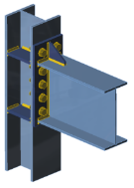
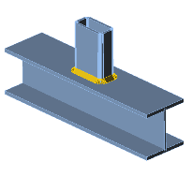
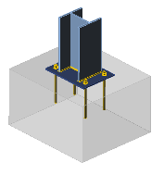
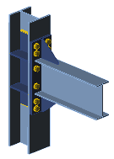
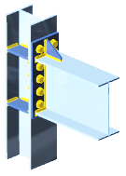
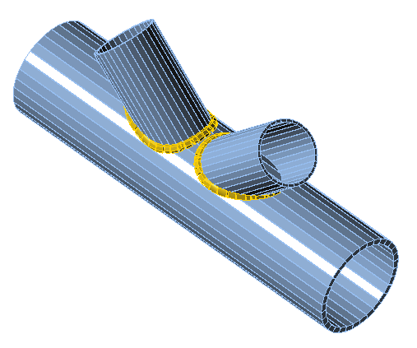
List of lectures
Beam to column moment connection
Hollow section joints
Joint of hollow to open section
Column base
Seismically qualified joints
Joints at elevated temperature

Slide 3
Aims and objectives
Provide information on joint modelling of open section joints
Introduce principles of CBFEM
Provide an online training to students and engineers
Illustrate the differences between numerical simulation and numerical calculation, e.g., between research-oriented FEM
and design-oriented FEM
Show the process of Validation & Verification
Offer a list of references relevant to the topic

Slide 4
Lecture 1
Beam to column moment connection
František Wald, Lukáš Gödrich, Marta Kuříková, Abhishek Ghimire,
Lubomír Šabatka, Jaromír Kabeláč, Drahoš Kojala

Slide 5

Tutorial
This lecture describes principles of FEA modelling of beam to column moment connection.
Survey of both simple and FEM analyses and modelling are shown.
Finally Validation, Verification and Benchmark case is presented.
Material was prepared under the R&D project MERLION II supported by Technology Agency of the Czech Republic, project No TH02020301.

Slide 6
Outline of the lecture
Introduction to design
  Design models
  Global analyses
  Classification
  Component method
  Interaction of internal forces
  Assessment I
Component Based Finite Element Method
  General
  Validation
  Verification
  Benchmark case
  Assessment II
Summary

Slide 7
Introduction to design
Lecture 1
Beam to column moment connection

Slide 8
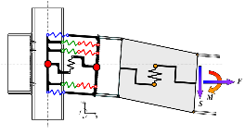
Past and Present design models
For joint design are available models:
  Experimental - history and contemporary design
  Curve fitting – currently hollow section joints design
  Analytical models
      Component Method (CM)
  Research oriented finite element method
  Design oriented finite element method
      Component based FE Method (CBFEM)
An example of component model for fire design
(Block et al 2005)
An example of curve fitting model, Kishi and Chen (1990)

Slide 9
Joints characteristics in bending
Major characteristics for joint in bending are
  Initial stiffness S_{j,ini}
    Small influence to distribution of internal forces
  Design resistance M_{j,Rd}
    Direct influence to resistance
  Deformation capacity φ_{Cd}
    Influence to plastic and seismic design only

Slide 10
Design model and experimental behaviour
The design model reflects the need of designers to safe prediction of joint behaviour
As structural elements are in joint designed for its material yielding f_{y} or its ultimate stress f_{u}
The experimentally reached resistance is never the asked design resistance

Slide 11
Joints deformability/stiffness
Joint deforms due to
  Shear force
    No influence to global distribution of internal forces
    Is closed during erection
  Normal force
    No influence to global distribution of internal forces
    Exception in space structures of course
  Bending moment
    Significant influence to distribution of internal forces
    The highest is in rectangular closed frames

Slide 12
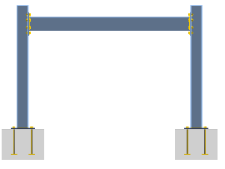

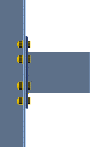
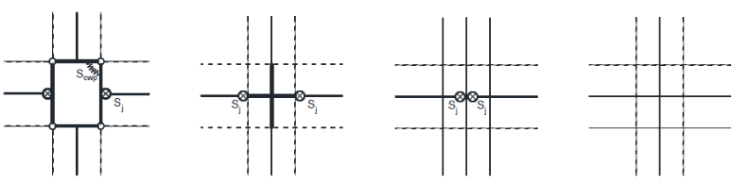
Joints in global analyses
Example of frame with its joints
If part of joint is flexible is in global analyses modelled as
Flexible column web panel and semi-rigid connections | Stiff column web panel and semi-rigid or pinned connections | Stiff column web panel and semi-rigid or pinned connections | Stiff column web panel and rigid connections

Slide 13
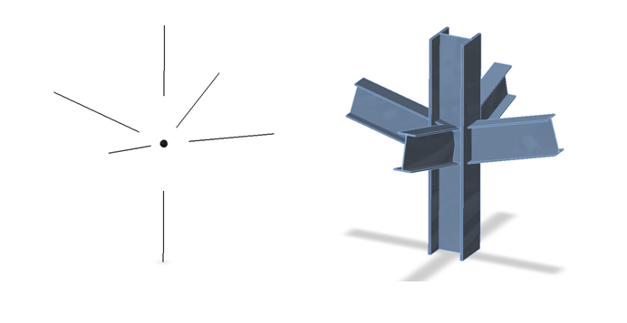
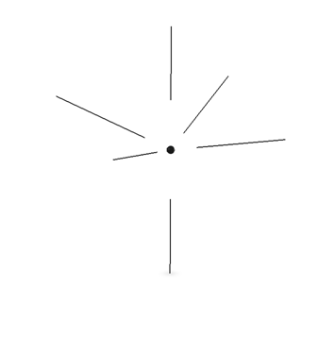
Physical and theoretical joint
In global analyses with 1D members are forces transferred to beam ends.
Forces are kept and moments are modified by action of forces on actual arms.
Theoretical joint should be in equilibrium, see example right below.
F₂
F₁
F₃
F₁ + F₂ + F₃ = 0

Slide 14
Classification
For global analyses of steel frames are joints classified to simplify the modelling.
(Preferable as pinned and rigid joints.)
According to Ch. 5 in EN1993-1-8:2006 are joints classified based on
  Best engineering practice
  Simplified assumption of frame behaviour
  Actual influence of particular joint to frame design.
  (This implicates recalculation.)

Slide 15
Classification based on resistance
Bending moment resistance of connection to bending moment resistance of connected beam is compared in connections loaded in bending.
  Full strength joints/connections M_{j,Rd} > M_{b,pl,Rd}
  Partial strength joints/connections M_{j,Rd} < M_{b,pl,Rd}

Slide 16
Classification based on rotational capacity
Rotational capacity of connection to rotational capacity of connected beam is compared in connections loaded in bending.
  Ductile connection
  Semi-ductile connection
  Brittle connection

Slide 17
Classification based on stiffness
Bending stiffness of connection to bending stiffness of connected beam is compared in connections loaded in bending.
  Rigid joint Sj,ini ≥ 25 E Ib / Lb (for frames without bracing)
  Semi-rigid joint Sj,ini,rigid ≤ Sj,ini ≥ Sj,ini,pinned
  Nominally pinned joint Sj,ini ≤ 0,5 E Ib / Lb
Relative moment
Rigid joints
Semi-rigid joints
Pinned joints
Relative stiffness

Slide 18
Component Method
Component method is analytical procedure to evaluate joint resistance and stiffness.
It consist of steps:
  Decomposition of joint to individual components based on assumed distribution of internal forces.
  Component description in terms of deformational stiffness and resistance.
  Joint behaviour assembly from the behaviour of its components based on assumed distribution of internal forces.

Slide 19
1) Decomposition of joint
In simplified procedures are joints design in one plane
Joint is decomposet to component based on best engineering practice
Example below is decomposition of the beam to column joint of open I/H sections with one end plate bolted connection is
    To components in column (❶❷❸❹), end plate connection (⑤⑩), and connected beam (⑦)
    Finally to rigid bodyand one spring

Slide 20
2) Component description
The structural properties of basic joint components are described in Chapter 6 of EN 1993-1-8 for some basic components, eg. for
  Column web panel in shear
  Column web in transverse compression
  Column web in transverse tension
  Column flange in bending
  End-plate in bending
  Flange cleat in bending
For composite joints are in EN1994-1-1:2005
For another joints in literature

Slide 21
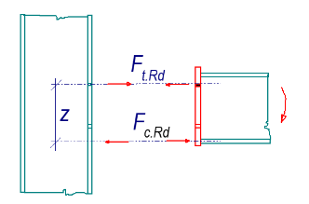
3) Joint assembly
Joint are assembled using the assumed lever arms of components z_{x}
assumed according to best engineering practice
E.g. for bolted connection with one bolt row may be guess simplified assembly
  F_{c,Rd} is compression force recon in the middle of bottom flange
  F_{t,Rd} is tensile force expected in the middle of bolt
  z is estimated lever arm

Slide 22
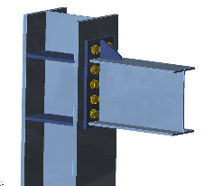
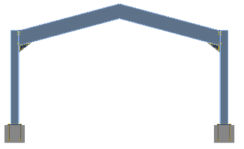
Interaction of bending moment and normal force
Many joints are exposed to interaction of bending moment and normal forces,
One example is simple portal frame, where the bolted eaves moment connection transmits the normal force based on the rafter inclination.
  The Normal force may be neglectabe
  but for greater inclination is for connection significant.

Slide 23
Simplified prediction of interaction of bending moment and normal force
In EN 1993-1-8:2005 is recommended:
  Design moment resistance of joint M_{j,Rd} does not take account of any axial force N_{Ed} in the connected member. Axial force in the connected member N_{Ed} should not exceed 5% of design plastic resistance of connected element N_{pl,Rd}.
  Otherwise should be considered by:
    Linear interaction
    Component method
  Interaction ratio is calculated to the vectors between points of the interaction curve.

Slide 24
Interaction of bending moment and normal force on beam to column joint with end plate
The significant points are marked.
The lines represents the limit of safe design by simple linear interaction and by component method.

Slide 25
Assessment I
Describe the influence to quality of design of the three major characteristics of joint
Principles of joint classification according to What Ch. 5 in EN1993-1-8:2006
What’s influence of joint deformation due to shear force, Normal force and bending moment
Draw the four possible representation of joints in global analyses.
Describe the three major steps of Component method.
How is in Component method predicted the lever arm of internal forces?
Describe the three major steps of Component method.
How to predict in a simple way interaction of bending moment and normal force?

Slide 26
Component Based Finite Element Method
Lecture 1
Beam to column moment connection

Slide 27
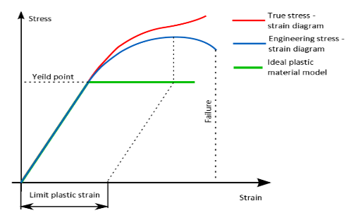
Material
Bilinear ideal elastic plastic diagram is used in design oriented models as CBFEM according to Ch. 7 in EN 1993-1-5:2006 and the slope of plastic branch is due to numerical stability E/1000.
Plastic strain in plates is limited by 5%.
In research oriented models is calculated the true stress-strain diagram from the material properties obtained in tensile tests, which is taking into account the necking of the coupon during its yielding before rupture.
True stress-strain
Experimental
Design
5%

Slide 28
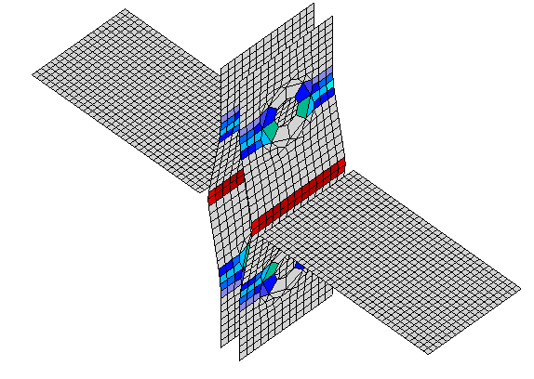
Plate
Four node quadrangle shell elements are applied with six degrees of freedom, i.e. three translations and three rotations, in every node.
End plates, element profiles, slender stiffener, T-stubs are modelled as plates connected in joint by constrains and the connection check is independent on the element size.
Example of T-stub shows the influence of mesh size on the T-stub resistance.
  Dashed lines are representing 5%, 10% and 15% difference.
15%
10%
5%
b_{f}
Half of flange width

Slide 29
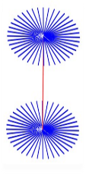


Bolt
Fan model with interpolation constrains to edges of bolt holes is used in CBFEM, but is used also in research oriented models (Bursi, Jaspart, 1998).
Nonlinear springs are connected for
  Tension in contact of
    bolt shank and bolt head
  Shear in contact between
    plate and bolt head
    bolt shank and plate
Fan model of bolt with constrains

Slide 30
Working diagram of spring model for Component bolt in tension
For bolt´s resistance is expected maximum allowed plastic strain ε_{mpb} as 25 % of elongation to fracture
of bolt according to EN ISO 898-1:2013, the values are summarised in Table below.
The stiffness in tension is calculated as k = E A_{s}/L_{b}, where A_{s} is tensile area of bolt and L_{b} is the distance between the centers of the head and the bolt nut.
Tensile force in bolt, kN
F_{t,Rd}
F_{t,el}
k_{t}
F_{c,Ed}
k
u_{el}
u_{t,Rd}
Bolt tesile deformation, mm
Maximum allowed plastic strains for bolts ε_{t,Rd}
Bolt grade 4.8 5.6 5.8 6.8 8.8 10.9
ε_{mpb} % 3,5 5,0 2,5 2,0 3,0 2,3

Slide 31
Working diagram of spring model for Component bolt in shear
Bolt in shear is simulated by bilinear diagram with its initial linear part and nonlinear one, which may be simplified as second linear one.
Values are obtained by experiments and summarised in design standards.
The values in Ch. 6 EN1993-1-8:2006 represents well the bearing of plate and bolt and shearing of the bolts shaft.
Shear force in bolt, kN
F_{t,Rd}
F_{t,el}
k_{t}
F_{c,Ed}
k
u_{el}
u_{t,Rd}
Bolt shear deformation, mm

Slide 32
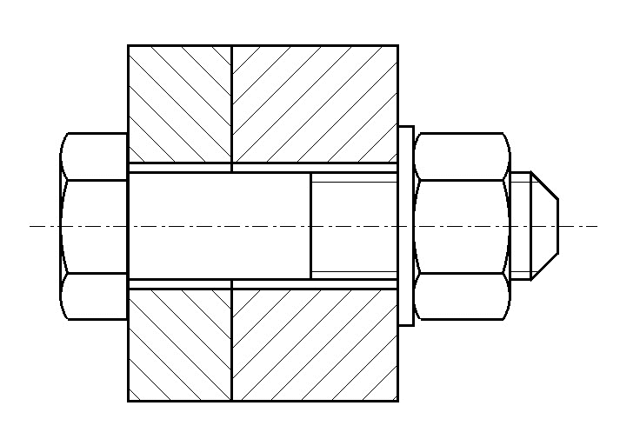
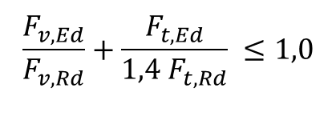
Bolt loaded in tension and shear
The bolt loaded to tensile resistance F_{t,Rd} has still significant shear residual resistance F_{s,res,Rd}.
The interaction is described by linear/nonlinear relation, which is in CBFEM simplified for initial and second part of the curve, see Figs below
$$\frac{F_{v,Ed}}{F_{v,Rd}}+\frac{F_{t,Ed}}{1,4 F_{t,Rd}} ≤1,0$$
F_{t,Ed}
Shear force
Tension
F_{t,Rd}
V
F_{t,Rd}
F_{t,el}
F_{t,el}
V
F_{t,Ed}
Shear deformation
Shear
F_{s,Rd}
u_{t,el}
u_{t,p}
u_{t,lim}
F_{s,el}

Slide 33

Bolts
Interaction diagram for deformation of the bolt loaded in shear and tension, (Wald et al. 2016)
Bolts tension deformation, δ_{t}
F_{t.Rd}
F_{t.Rd}
F_{t.el}
F_{t.el}
δ_{t,Rd}
Bolts tension force, F_{t,Ed}
r.δ_{v,Rd}
δ_{t,el}
r.δ_{v,el}
$$r=\frac{1,4−1}{1.4}$$
Bolts shear deformation, δ_{v}
δ_{v,el}
δ_{v,Rd}

Slide 34
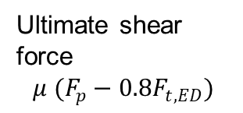
Slip resistant bolt
In the preloaded slip resistant bolt is transferred the shear force by friction.
As the friction force is reached slip resistance the shear force is transferred by bearing of the plate and shearing of bolt as regular non preloaded bolt.
Bolt is preloaded to 70% of its strength.
F_{t,Ed}
Shear force V
Bolt model
Ultimate shear force
$$μ (F_{p}−0.8F_{t,ED})$$
V
V
F_{p}
Connection slippage
F_{p}
F_{t,Ed}
Shear deformation

Slide 35
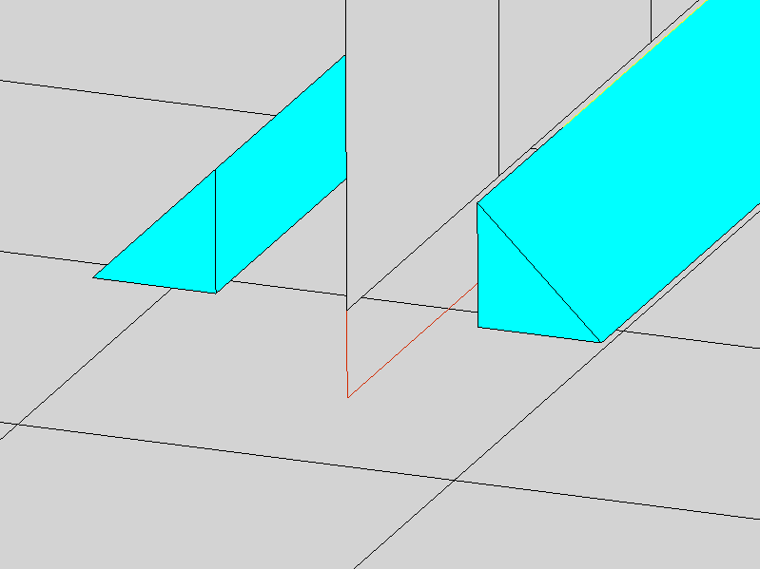
Welds
Filled weld is modelled by equivalent solid elastoplastic element, which is added between plates to express the weld behaviour, see Fig. below.
The element respects the weld throat thickness, position,
and orientation to assure good representation of weld deformation stiffness, resistance and deformation capacity.
The plastic strain in weld is limited to 5%.
Equivalent stress
τ
σ
Weld throat section
Equivalent solid element
Multipoint constraint
Multipoint constraint
Wald et al. (2016)

Slide 36
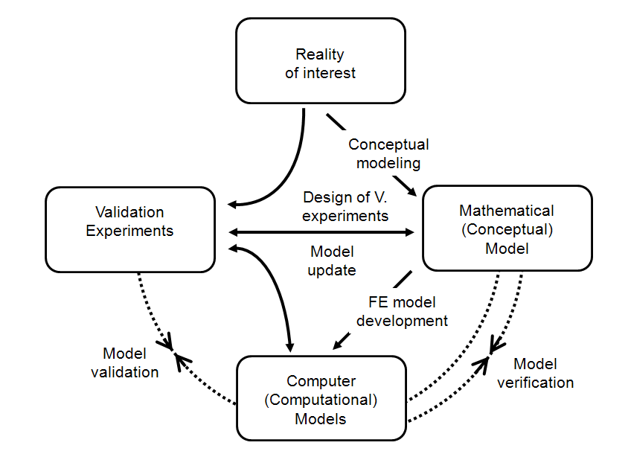
Verification & Validation
The need and position of Verification & Validation in prediction of the reality is demonstrated on the diagram below.
Kwasniewski L. (2009)

Slide 37
Terminology
Validation
  compares the numerical solution with the experimental data.
Verification
  uses comparison of computational solutions with highly accurate analytical or numerical solution.
Benchmark case
  ais example for check of the software and its user by validated and simplified input and output.

Slide 38
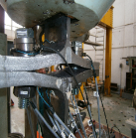
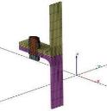
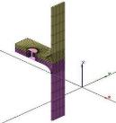
Design and research oriented model
Current approval of design models consist of
  Experiments
Research oriented FE model (ROFEM)
  is validated on experiment.
  Numerical experiments are prepared.
Design oriented
analytical/numerical model (AM/DOFEM)
  is verified to numerical experiments and/or another design models.
  Sensitivity study is prepared.
  Validity range is defined.
Benchmark case (BC)
  is prepared to help the users of model to check up its correctness and proper use.
Experiment
Research model
Design model

Slide 39
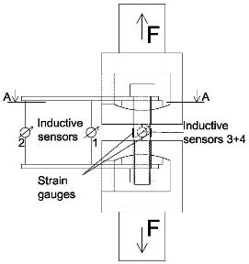
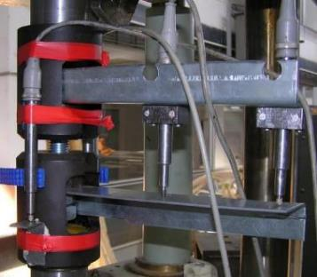
Experiments with bolts in tension
Out of dozens of published tests, 13 bolts of different lengths and diameter were tested to obtain the detailed force-deformation behaviour.
Bolts elongation was measured by inductive sensors.
Bolts were fixed to the testing machine by special tools with bearing caps to ensure hinges on its ends.
Testing machine
Inductive sensors arrangement

Slide 40
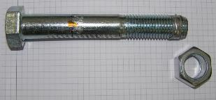
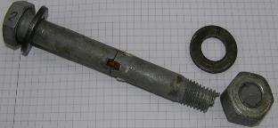


Failure modes of bolts in tension
There are four possible failure modes of bolts loaded in tension:
Stripping of nut threads
Rupture of bolt close to nut
Stripping of bolt threads
Rupture of bolt close to head

Slide 41
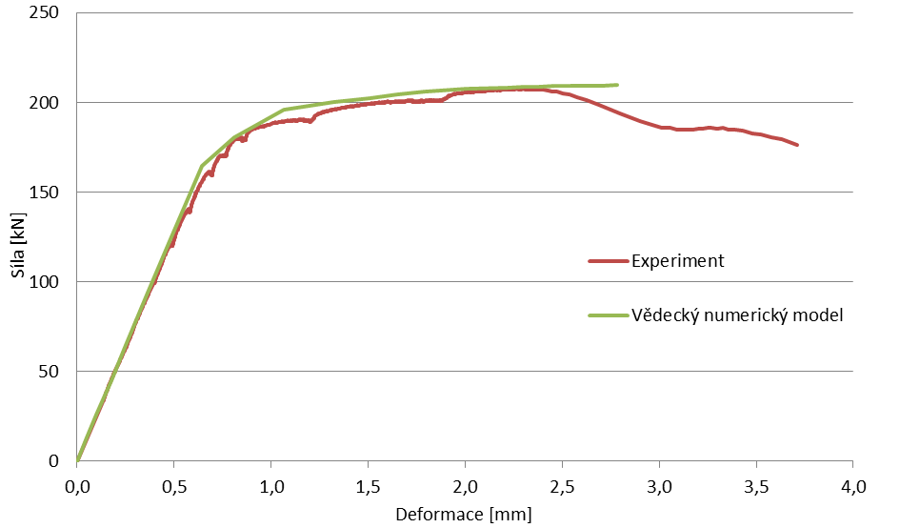

Validation for rupture of bolt close to head
The figure shows the validation of research oriented model in case of failure mode rupture of bolt close to the bolt head.
Force [kN]
Experiment
Research FEM
Research oriented model of bolt
Deformation [mm]
Rupture of bolt close to head

Slide 42
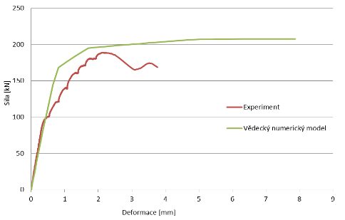
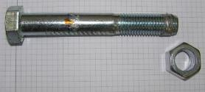
Validation of stripping of nut thread
The validation of the research oriented model in case of failure mode stripping of the nut thread is presented below.
Force [kN]
Experiment
Research FEM
Research oriented model of bolt
Deformation [mm]
Stripping of nut threads

Slide 43
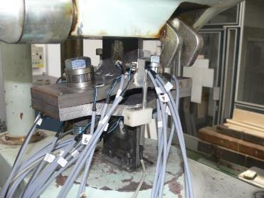
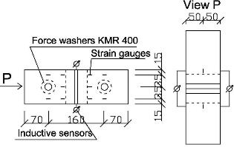
Experiment with T-stub in tension
Two specimens were prepared with T stubs,
cross sections HEB300 and HEB400 with bolts M24 8.8.
T-stub deformation was measured by inductive sensors.
Strains were measured on the expected yielding lines on flanges by strain gauges.
Forces in the bolts were measured by KMR400 rings placed under the bolt heads.
Measuring devices arrangement
Testing machine

Slide 44
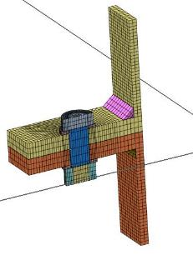
Validation of research model of T-stub in tension
The Figure shows the validation of the research oriented model of T-stub from HEB300 loaded in tension.
Research oriented model of T-stub

Slide 45
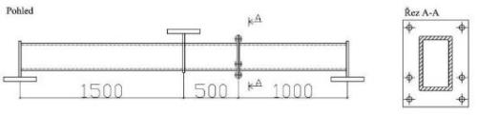
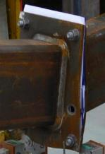
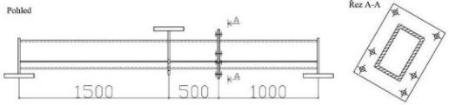
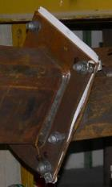
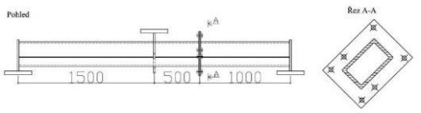
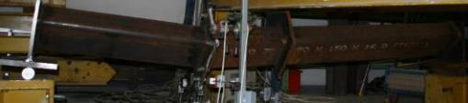
Experiments with generally positioned end plates
The experiments were prepared with three bolted beam to beam end plate connections.
0°
30°
45°

Slide 46

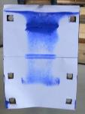
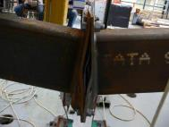
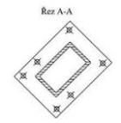


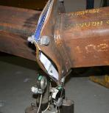

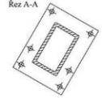
Parameters of speciments for the generally positioned end plate
Plate P20 – 400 x 300 mm
Steel S355 (f_{y,exp} = 410 MPa; f_{u, exp} = 582 MPa)
Bolts M20 - 8.8
Pitches vertical (35 – 230 – 100 - 35 mm)
horizontal (30 – 240 – 30 mm)
0°
45°
30°

Slide 47
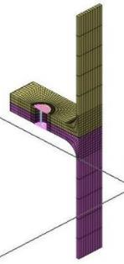
Verification of T-stub in tension
The Figure shows the verification of the design oriented model of T-stub from HEB300 loaded in tension to research oriented FE model. Comparison to component method is included.
Component method
CBFEM
Research FEM
Design oriented model of T-stub

Slide 48
Verification of T-stub in tension
The sensitivity study of thickness of the flange shows higher resistance according to CBFEM compared to CM for samples with flange thicknesses up to 20 mm.
ROFEM gives even higher resistance for these samples.
Higher resistance of both numerical models is due to neglection of membrane effect in CM.
CM
CBFEM
ROFEM

Slide 49
Verification of T-stub in tension
To show the prediction of the CBFEM model, results of the studies are summarized in graph comparing resistances by CBFEM and component method. The results show that the difference of the two calculation methods is mostly up to 10%.
In cases with CBFEM/CM > 1,1 accuracy of CBFEM is verified by the results of Research oriented FEM, which gives highest resistance in all selected cases.
Variation of Plate thickness
Bolt size
Bolt material
Bolt distance
T-stub thickness

Slide 50
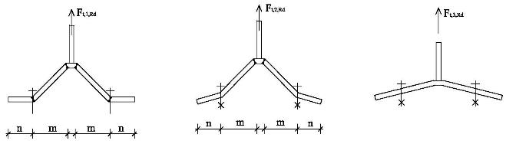


Verification of T-stub in tension
Three failure modes of T-stub are considered.
Component Method
Full yielding of flange
Yielding of flange and rupture of bolts
Rupture of bolts
Component Based FEM
Yielding of flange
Bolt resistance

Slide 51
Verification of generally loaded end plate
Resistance calculated by CBFEM is compared with the results of CM and experimental results. The sensitivity study is focused on ratio of bending moments in strong and week axis, see Figure below.
CM with linear interaction gives conservative values of resistance.
CM with quadratic interaction gives the highest resistances, which are to experimental results still rather conservative.
CBFEM gives similar results as CM with quadratic interaction.
Experiment
CM – Linear interaction
CM – Quadratic interaction
CBFEM

Slide 52
Verification of end plate
A comparison of the global behavior described by the moment-rotation diagram is prepared. Attention is focused on initial stiffness, resistance and deformation capacity.
Sample 0° with strong axis bending moment is selected to present as reference, see Figure below.
CM gives higher initial stiffness compared to CBFEM and experimental data.
Resistance predicted by CM and CBFEM is similar.
The resistance obtained experimentally is higher.

Slide 53

Benchmark case T-stub
Inputs
T-stub
  Steel S235
  Flange thickness t_{f} = 20 mm
  Web thickness t_{w} = 20 mm
  Flange width b_{f} = 300 mm
  Length b = 100 mm
  Double fillet weld a_{w} = 10 mm
Bolts
  2 x M24 8.8
  Distance of the bolts w = 165 mm
Outputs
  Design resistance in tension F_{T,Rd} = 175 kN
  Collapse mode - full yielding of the flange with maximal strain 5 %
  Utilization of the bolts 88,4 %
  Utilization of the welds 49,1 %

Slide 54


Benchmark case end plate connection
Inputs
  Steel S235
  Beam IPE 330
  Column HEB 300
  End plate height h_{p} = 450 (50-103-75-75-75-73) mm
  End plate width b_{p} = 200 (50-100-50) mm
  End plate P15
  Column stiffeners 15 mm thick and 300 mm wide
  End plate stiffener 10 mm thick and 90 mm wide
  Flange weld throat thickness a_{f} = 8 mm
  Web weld throat thickness a_{w} = 5 mm
  Bolts M24 8.8
Outputs
  Design resistance in bending M_{Rd} = 209 kNm
  Corresponding vertical shear force V_{Ed}= 209 kN
  Collapse mode - yielding of the beam stiffener on upper flange
  Utilization of the bolts 89,5 %
  Utilization of the welds 87,2 %

Slide 55
Assessment II
How is limited plastic strain for design of resistances of plates?
How is simplified the convergence of finite elements procedure of steel members and plates?
How is modelled the bolt model in CBFEM?
How is modelled interaction bolts loaded at the same time in shear and tension?
As how is transferred the shear force as the slip resistance bolt reach its resistance?
Why is filled weld modelled by equivalent solid elastoplastic element, which is added between plates?
How differs validation from verification?
What are two major purposes of benchmark cases in application of FEA analyses?

Slide 56
Summary
Lecture 1
Beam to column moment connection

Slide 57
Summary
The design of beam to column moment connections is focussed to preferable yielding of steel plates and brittle failure of fasteners, bolts, welds.
The design of beam to column moment connection by Component Method (CM) is very accurate in components behaviour modelling.
The lever arm is in CM estimated based on the best engineering practice. Its prediction is good in well know and tested connections and joints. Its educated guess affects the resistance.
The CM is prepared for software tools and design tables not for had calculation.

Slide 58
Summary
The design of connections by finite element method is not replication of the physical experiment. The designer is interested into the limited yielding of steel plates and failure of fasteners.
Component based finite element method (CBFEM) is taking advantage of accurate modelling of component behaviour based on experiment and accuracy of discrete analyse of steel plate by FEM
The Validation and Verification procedure is integral part of any finite element analyses. The procedure is checking the software and the use by designer.
CBFEM offers the designer a discrete view on the behaviour, see next slides.

Slide 59



Prediction of global and local behaviour
Beam to column connection
Full depth end plate 25 mm
Rafter IPE 400
Column HEA 320
12 bolts M24 8.8
Haunch 700x300 mm
Flange 15x150 mm
Stiffeners P20
Steel S355

Slide 60


Global and local behaviour
M = 100 kNm
Fi = 3,2 mrad
Si = 31,6 MNm/rad
Moment, kNm
Rotation. mrad
Column flange plastification round bolts
Well designed steel connection starts to classify early to allow plastic distribution of forces between connectors.

Slide 61

Global and local behaviour
M = 150 kNm
Fi = 4,8 mrad
Si = 31,6 MNm/rad
Moment, kNm
Rotation. mrad
Column web plastification

Slide 62

Global and local behaviour
M = 180 kNm
Fi = 5,7 mrad
Si = 31,5 MNm/rad
Moment, kNm
Rotation. mrad
Progress of column web plastification

Slide 63

Global and local behaviour
M = 220 kNm
Fi = 7,3 mrad
Si = 30,0 MNm/rad
Moment, kNm
Rotation. mrad
Progress of column web plastification

Slide 64

Global and local behaviour
M = 250 kNm
Fi = 10,7 mrad
Si = 23,4 MNm/rad
Moment, kNm
Rotation. mrad
Column web full plastification

Slide 65

Global and local behaviour
M = 260 kNm
Fi = 14,7 mrad
Si = 17,4 MNm/rad
Moment, kNm
Rotation. mrad
Column flange on opposite side plastification

Slide 66

Global and local behaviour
M = 270 kNm
Fi = 23,4 mrad
Si = 11,5 MNm/rad
Moment, kNm
Rotation. mrad
Beam above haunch starts yield

Slide 67

Global and local behaviour
M = 280 kNm
Fi = 43,6 mrad
Si = 6,4 MNm/rad
Moment, kNm
Rotation. mrad
Further plastification

Slide 68

Global and local behaviour
M = 290 kNm
Fi = 78,6 mrad
Si = 3,7 MNm/rad
Moment, kNm
Resistance reached
By 5% strain in column web loaded in shear and compression.
Well designed steel connection starts to plasticize early
to allow plastic distribution of forces between connectors/plates.
Rotation, mrad

Slide 69


Global and local behaviour
Moment, kNm
Resistance
Initial stiffness
Deformation capacity
Rotation, mrad
The major joint in bending design characteristics
where S_{j,ini} is the initial stiffness,
M_{j,Rd} is the design bending resistance,
φ_{Cd} is the deformation capacity
are well described.

Slide 70




What is the major reason of using CBFEM for Beam to column moment connections?
Generally loaded complex joints
is difficult to design in space accurately by
Component or other methods.
The example of design procedure by CBFEM is shown below.
3D model Finite element analyses Design check

Slide 71
Thank your for attention
URL: steel.fsv.cvut.cz
František Wald, Lukáš Gödrich, Marta Kuříková, Abhishek Ghimire,
Luboš Šabatka, Jaromír Kabeláč, Drahoš Kojala

Slide 72
Notes to users of the lecture
Subject Design of the open sections joints.
Lecture duration 60 mins.
Keywords Civil Engineering, Structural design, Steel structure, Beam to column connection, Beam to beam connection, Beam spices, Open section, Joint, Component Method, Component based Finite Element Method, Eurocode.
Aspects to be discussed Experiments, Reasons and methods of classification, Principles of CM, Major components in CM, Interaction of forces, Components in CBFEM, Principles of CBFEM, Validation and Verification.
Further reading relevant documents in references and relevant European design standards, Eurocodes including National Annexes.
Preparation for tutorial exercise see examples in References.

Slide 73
Sources
To Component Mehod
Agerskov H., High-strength bolted connections subject to prying, Journal of Structural Division, ASCE, 102 (1), 1976, 161-175.
Block F.M., Davison J.B., Burgess I.W., Plank R.J., Deformation-reversal in component-based connection elements for analysis of steel frames in fire, Journal of Constructional Steel Research, 86, 2013, 54-65.
Da Silva L., Lima L., Vellasco P., Andrade S., Experimental behaviour of end-plate beam-to-column joints under bending and axial force, Database reporting and discussion of results, Report on ECCS-TC10 Meeting in Ljubljana, 2002.
Da Silva L., Towards a consistent design approach for steel joints under generalized loading, Journal of Constructional Steel Research, 64, 2008, 1059-1075.
Chen, W.F., Abdalla K.M., Expanded database of semi-rigid steel connections, Computers and Structures, 56, (4), 1995, 553-564.
Kishi N., Chen W.F. Moment‐Rotation Relations of Semirigid Connections with Angles, Journal of Structural Engineering, 116 (7), 1990, 1813-1834.
Zoetemeijer P., Proposal for Standardisation of Extended End Plate Connection based on Test results - Test and Analysis, Ref. No. 6-83-23, Steven Laboratory, Delft, 1983.
Zoetemeijer P., Summary of the research on bolted beam-to-column connections, TU-Delft report 26-6-90-2, Delft, 1990.
  .

Slide 74

Sources
To Component Based Finite Element Mehod
  Bursi O. S., Jaspart J. P., Benchmarks for Finite Element Modelling of Bolted Steel Connections, Journal of Constructional Steel Research, 43 (1-3), 1997, 17-42.
Kwasniewski L., On practical problems with verification and validation of computational models, Archives of Civil Engineering, LV, 3, 2009,
323-346.
  Oberkampf, W.L. TrucanoT.G., Hirsch C., Verification, validation, and predictive capability in computational engineering and physics, Appl. Mech. Rev. 57 (5), 345–384, 2004
  Virdi K. S. et al, Numerical Simulation of Semi Rigid Connections by the Finite Element Method, Report of Working Group 6 Numerical, Simulation COST C1, Brussels Luxembourg, 1999.
Wald F. et al, Benchmark cases for advanced design of structural steel connections, Česká technika ČVUT, 2016.
Wald F., Gödrich L., Šabatka L., Kabeláč J., Navrátil J., Component Based Finite Element Model of Structural Connections, in Steel, Space and Composite Structures, Singapore, 2014, 337-344.

Slide 75
Standards
EN1992-1-1, Eurocode 2, Design of concrete structures, Part 1-1, General rules and rules for buildings, CEN, Brussels, 2005.
EN1993-1-5, Eurocode 3, Design of steel structures, Part 1-5, Plated Structural Elements, CEN, Brussels, 2005.
EN1993-1-8:2006, Eurocode 3, Design of steel structures, Part 1-8, Design of joints, CEN, Brussels, 2006.
EN1994-1-1:2010, Eurocode 4, Design of composite steel and concrete structures, Part 1-1, General rules and rules for buildings, CEN, 2010.
ISO 898-1, Mechanical properties of fasteners made of carbon steel and alloy steel, Part 1, Bolts, screws and studs with specified, property classes, Coarse thread and fine pitch thread, Geneva, 2013

